Slide 1

Stefan Hervø-Hansen Osaka University Technical University of Denmark December 12, 2024
Notes:
Just short of 13,000 named mountains in Japan

Slide 2

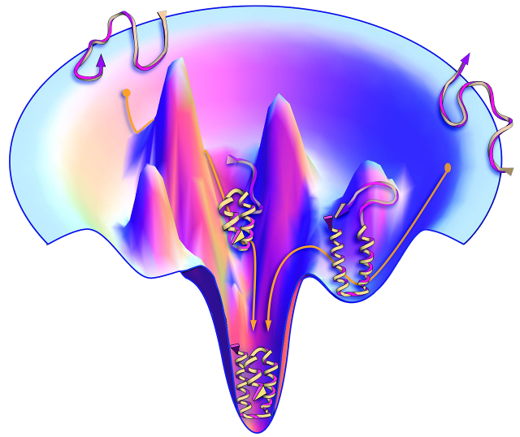
Understanding protein (un)folding and (mis)function
Osaka University
Structural parameter 1
Structural parameter 2
Adapted from Dill/Stony Brook University
Notes:
Mountains and valleys of the protein conformational landscape.
However, the landscape changes depending on the actions we take with the protein.

Slide 3
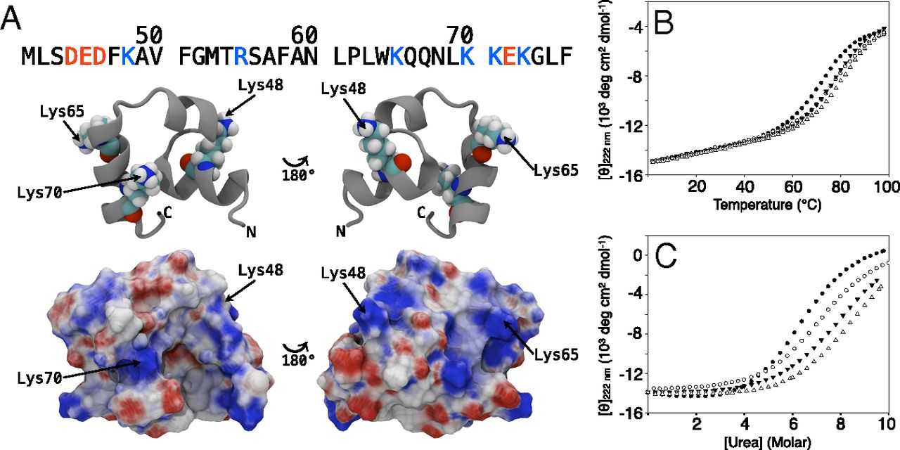
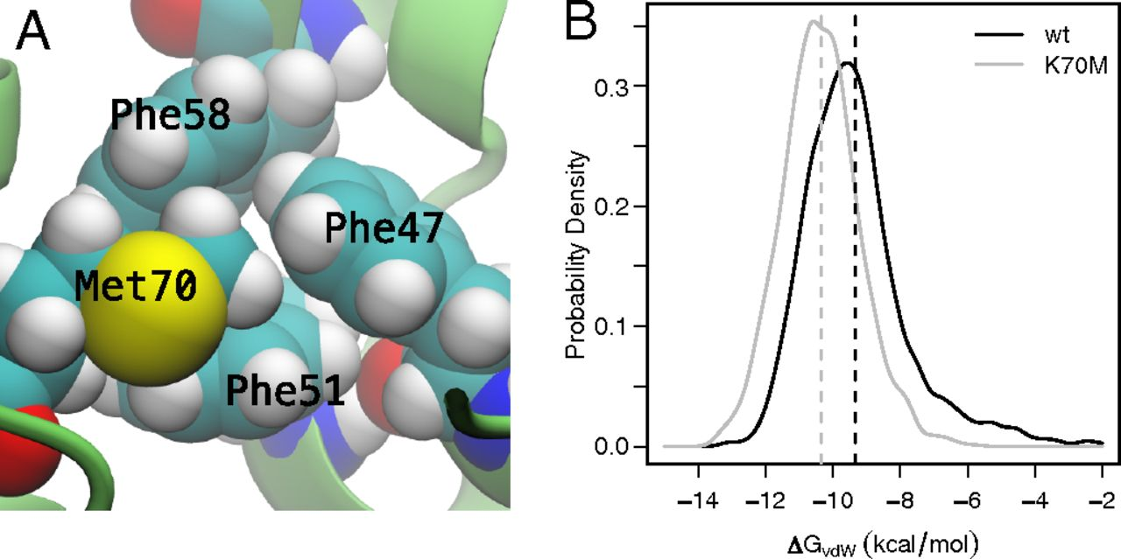
Rational modifications of proteins often lead to complicated results
Osaka University
A supposed electrostatics problem turned into a hydrophobic packing problem.
Emphasizes the importance of protein dynamics and relaxation
Xiao et al., PNAS, 2013
Notes:
Studies during my master's worked hard to understand protein modifications. Villin headpiece subdomain (HP36).

Slide 4
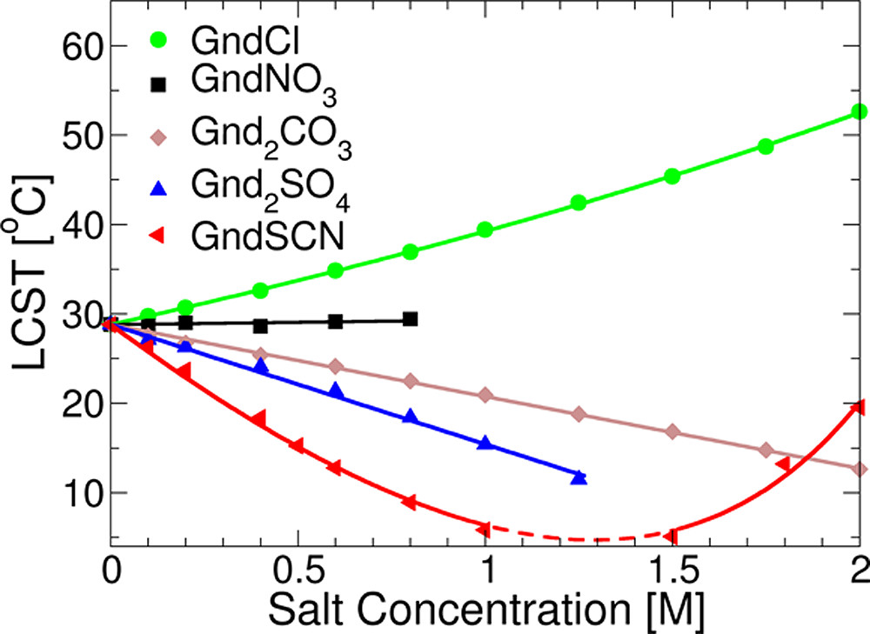
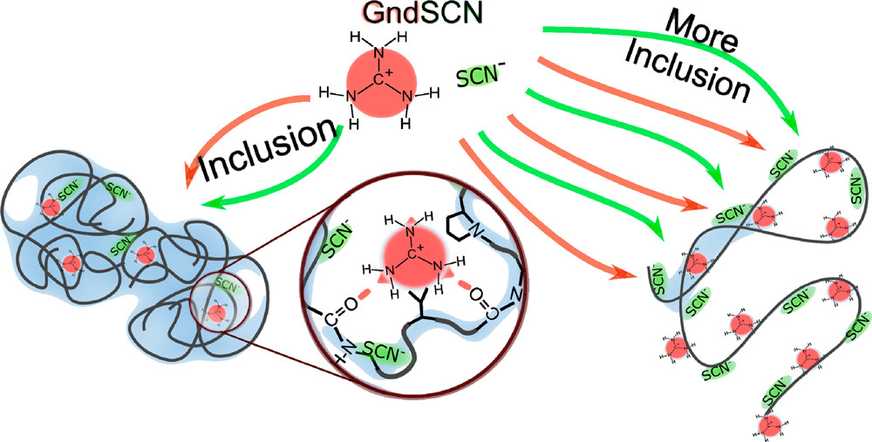
Rational modifications of proteins often lead to complicated results
Osaka University
Cosolvents may exhibit specific and universal interactions in protein equilibria perturbation
Heyda et al., JACS, 2017
Notes:
Guanidinium thiocyanate exhibits both the ability to salt-in and salt-out. Elastin-like polypeptide.

Slide 5
Adding more variables to the problem
Osaka University
Structural parameter 1
Structural parameter 2
Observable space
Controllable space
Solvent modifications
Protein modifications
Adapted from Dill/Stony Brook University
Notes:
What is the connection between our controllable space and observable space at the microscopic level? Can it be harnessed and transferred?

Slide 6
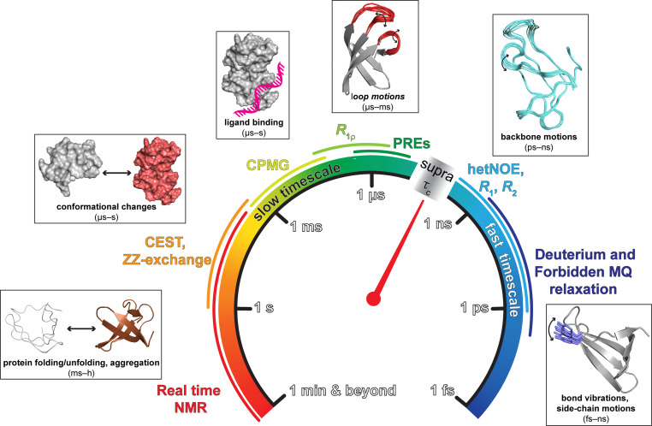
The timescales and resolutions of protein chemistry
Osaka University
Kawale et al., 2023

Slide 7
Degree of Coarse-Graining depends on size and time
Osaka University
Hervø-Hansen, Ph.D. Thesis, 2021

Slide 8


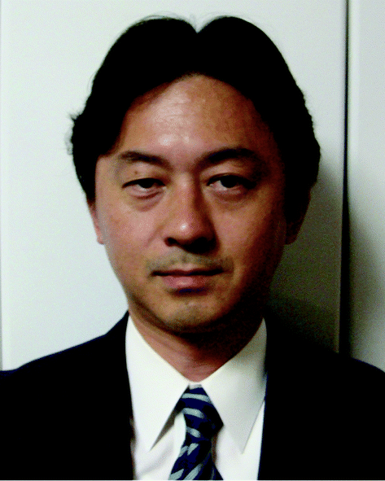
My journey from experimental biochemistry to computational chemistry
Osaka University
Kresten Lindorff-Larsen,
University of Copenhagen
Mikael Lund,
Lund University
Nobuyuki Matubayasi,
Osaka University
time
Notes:
Kresten: Computational Protein Chemistry
Mikael: Molecular simulations & Statistical thermodynamics
Nobuyuki: Classical density functional theory & Statistical physics

Slide 9
Combining Machine Learning and Physics-Based Simulations for Smart Design and Understanding of Molecular Materials
Osaka University

Slide 10
Outline
Osaka University
Motivation
Molecular simulations & Free energy calculations
Applications
Controlling protein electrostatics (Protein stability)
Binding and conformational change (Ligand binding)
Co-solvent effects on polymers (Protein solubility)

Slide 11
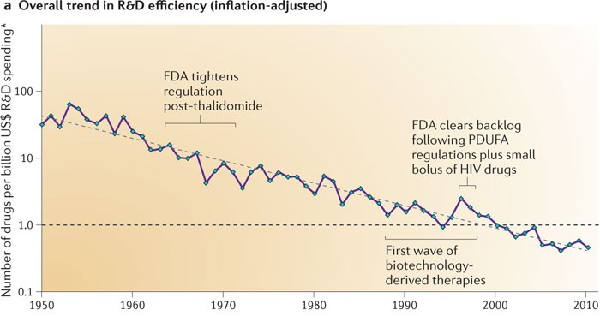
Motivation
Osaka University
Scannell et al., Nat Rev Drug Discov, 2012
Notes:
Drug and materials discovery is a complex, expensive, and time-consuming process

Slide 12
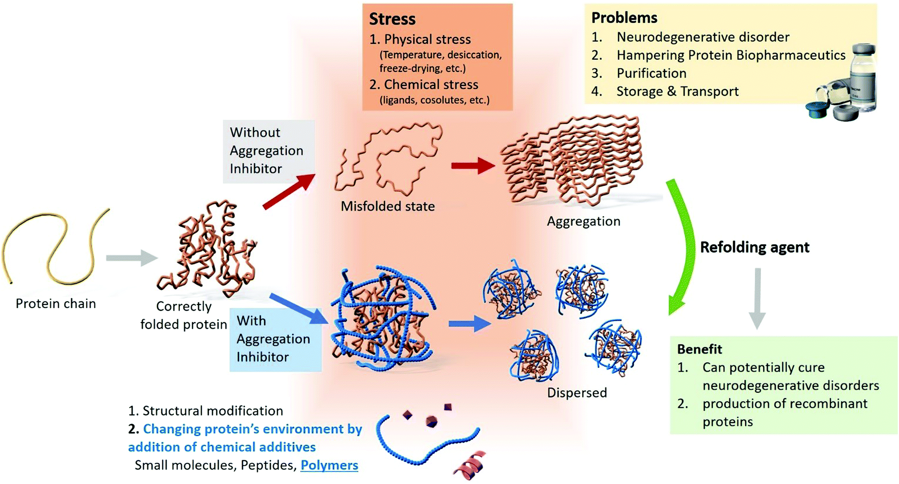
Proteins are highly responsible polymers
Osaka University
Rajan et al., Mater. Adv., 2021
Notes:
Current paradigm of protein chemistry: Wrongly folded proteins tend to be toxic and, unless refolded or degraded, will lead to diseases.

Slide 13
Rational protein engineering to obtain improved or new novel properties
Osaka University
Extrinsic alterations: Alterations of the polymer environment
Small molecules (ATP, salts, amino acids, sugars)
Crowding agents (PEG, Dextran, DNA, RNA, other proteins)
Intrinsic alterations: Alterations of the polymer itself
Amino acid substitution
Post-translation modifications (alkylation, acetylation, ubiquitination)
Structural stability, Solubility, Catalytic efficiency, Fibrillation propensity
Notes:
ATP is a naturally occurring co-solvent present at higher levels than what is needed purely for energy considerations.

Slide 14
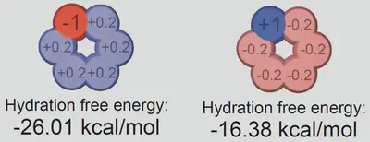
Solvation free energies to understand underlying physics of liquid structure
Osaka University
RAPID QUIZ :
Which of the two (left or right) is more soluble in water?
Molecular simulations yields a direct link between liquid structure and thermodynamics
Mobley et al., J Phys Chem B, 2008
Notes:
Left is more soluble.
These asymmetries are mainly enthalpic, arising primarily from the first solvation shell water structure.
Effects are not captured by implicit solvent models, which respond symmetrically with respect to charge.
Toy models / coarse graining: Remove the noise of what makes a chemical species special to understand universal effects.

Slide 15
Outline
Osaka University
Motivation
Molecular simulations & Free energy calculations
Applications
Controlling protein electrostatics (Protein stability)
Binding and conformational change (Ligand binding)
Co-solvent effects on polymers (Protein solubility)

Slide 16
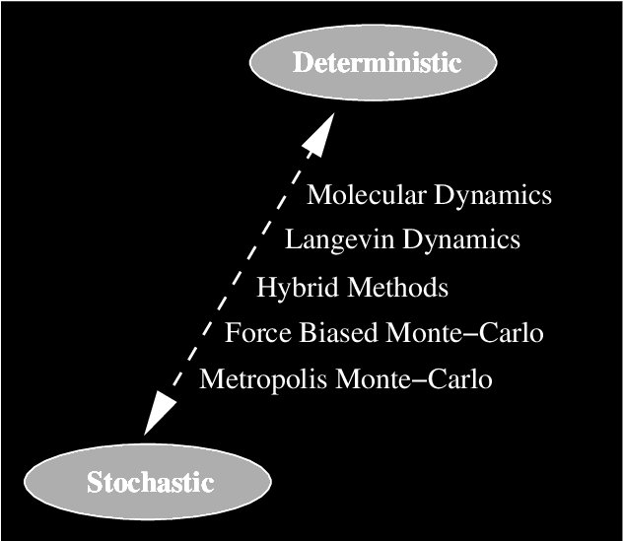
Molecular simulations
Osaka University
Molecular Dynamics
Solve Newton’s equations of motion to propagate nuclei coordinates in time
Markov Chain Monte Carlo
Generate probability distribution from a sequence of random samples

Slide 17
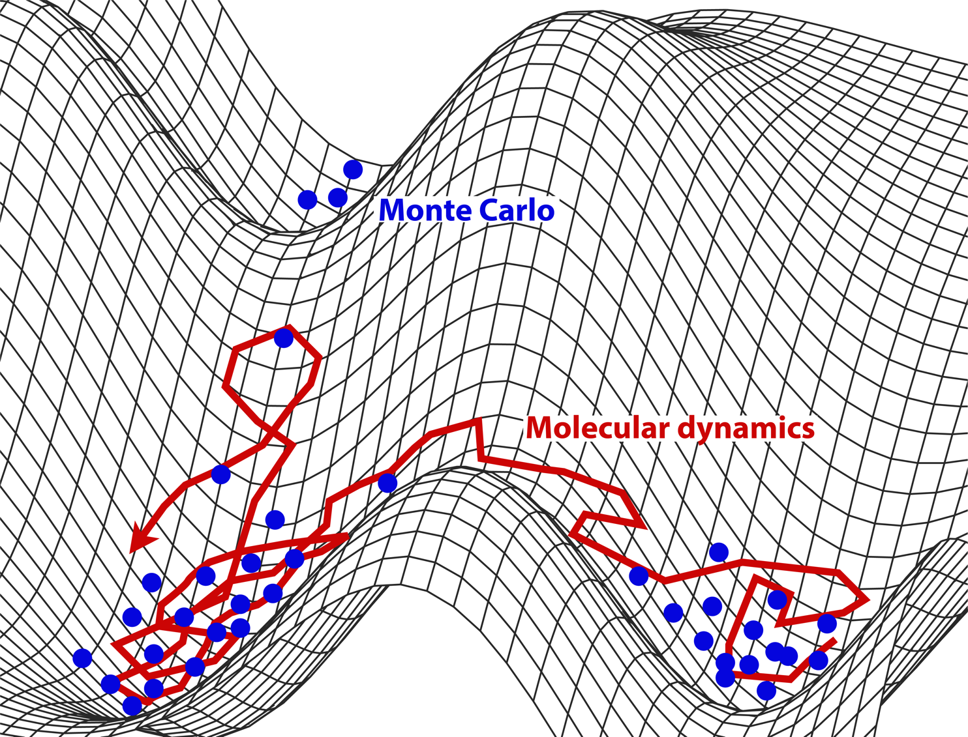
Molecular Dynamics
Osaka University
Numerically solve kinematic equations
Addition of thermostats and barostats to obtain desired thermodynamic ensemble
Configurations are connected in time thus kinetics are maintained causing high energy barrier crossing difficult

Slide 18
Monte Carlo simulations
Osaka University
Generate Boltzmann-distributed configurations with equal weight
New configurations are generated by trial moves:
Translation
Rotation
Change thermodynamic state
Monte Carlo requires strong chemical and physical intuition about the system to be effective

Slide 19
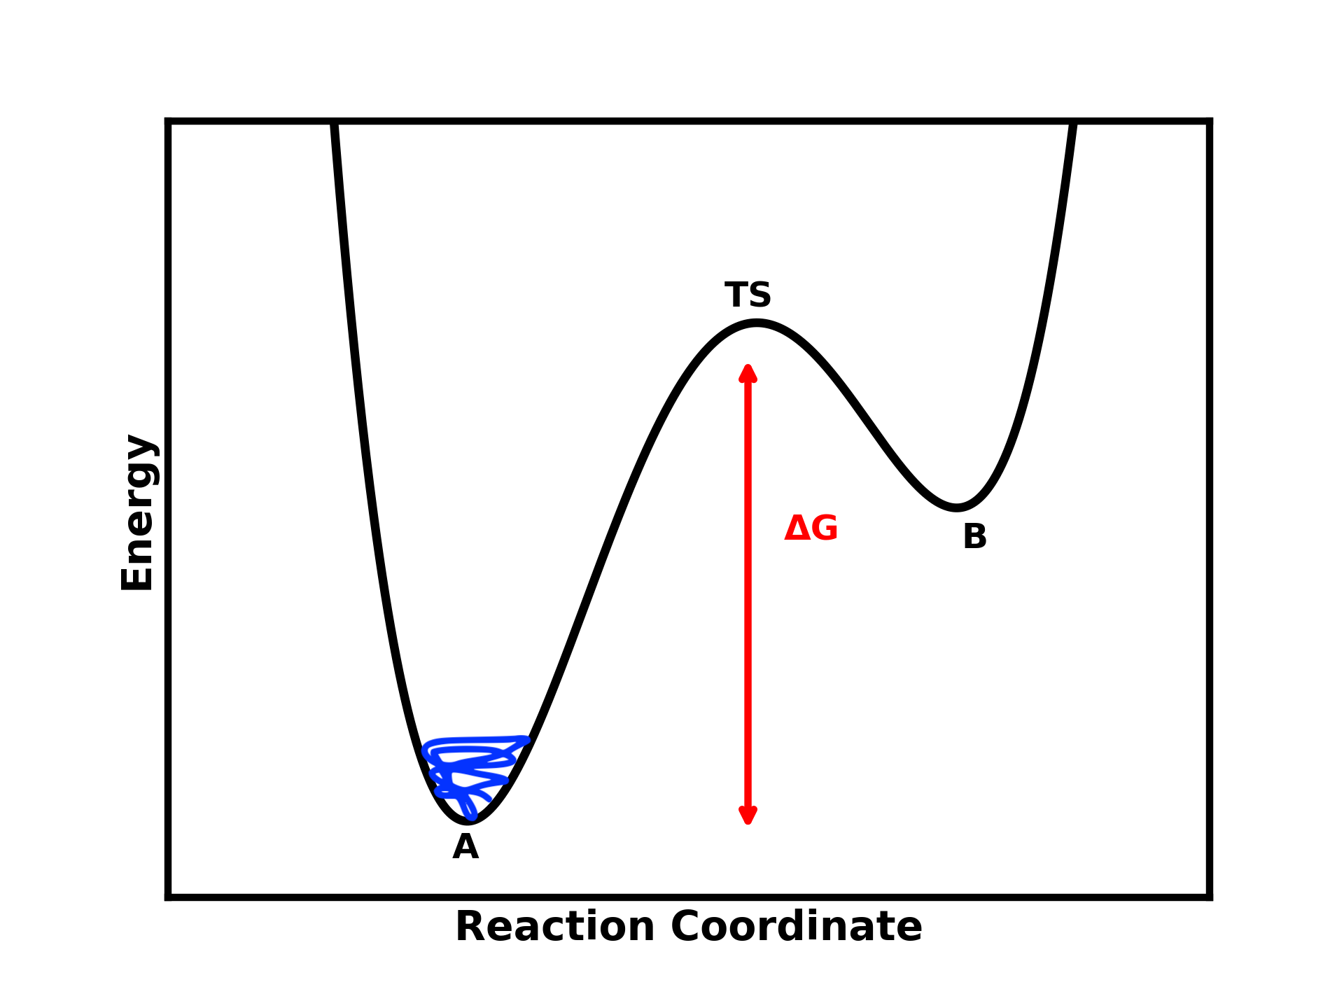



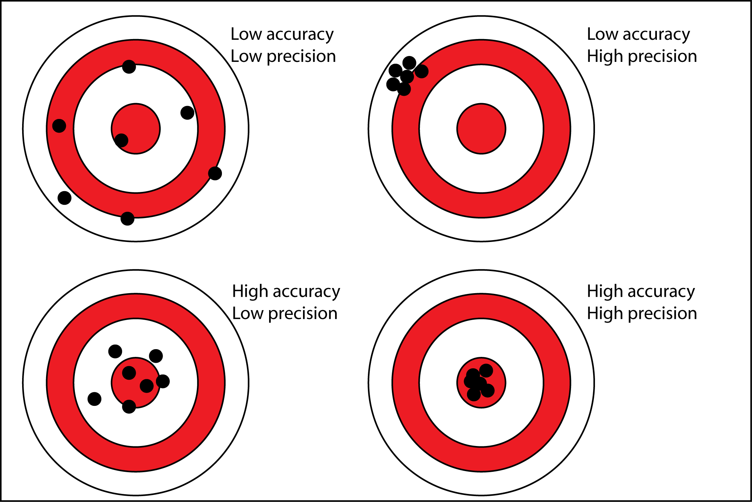
Force Fields and Sampling
Osaka University
Bonded interactions
Non-bonded interactions
Improved sampling
Improved
force
field
Notes:
Classical description of chemical bonding: unbreakable
Two fold problem: accuracy vs precision
Sampling: precision
Force field: accuracy

Slide 20
Free energy calculations
Osaka University
Central to many questions in biological and pharmaceutical chemistry
Common questions:
How does compound X partition itself between the aqueous and oil phase? (membrane)
How tightly does compound X bind protein Y?
How do modifications in compound X modulate affinity and selectivity?
How do target mutations in Y affect binding affinities?

Slide 21

Free energy calculations – Foundation
Osaka University
Important points:
Determination of absolute free energies is impossible.
All transformations must be conducted isothermally.
Notes:
Absolute free energies are slow converging functions (ever increasing function as you integrate over phase space) -> ratio to speed it up.
Isothermal condition ensures it being a ratio problem.
We can ask: ”How does process dG of process X change with temperature?”

Slide 22

Free energy calculations – Brute Force Sampling
Osaka University
unbound
For systems with an off-rate of 10⁻⁴ s⁻¹ we would would need hours in simulated time to obtain reliable statistics.
bound
time
Notes:
Half-life constant of approximately 2 hours for first-order reactions (activation free energy of aprox 23 kcal/mol at 298.15 Kelvin).

Slide 23


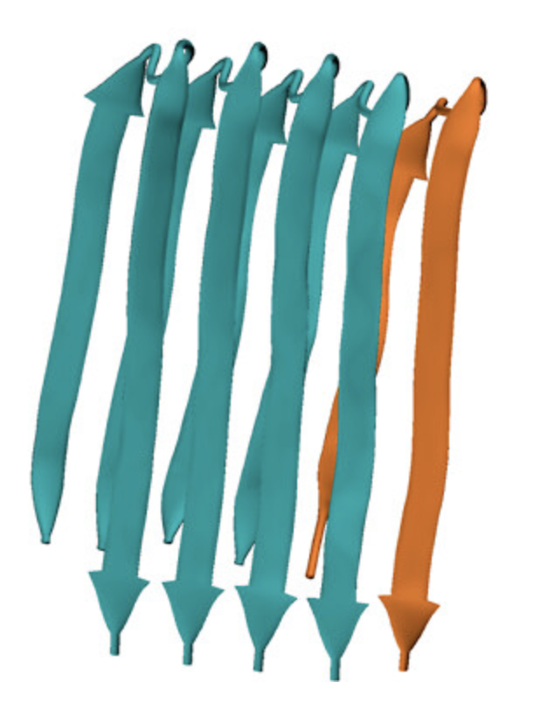
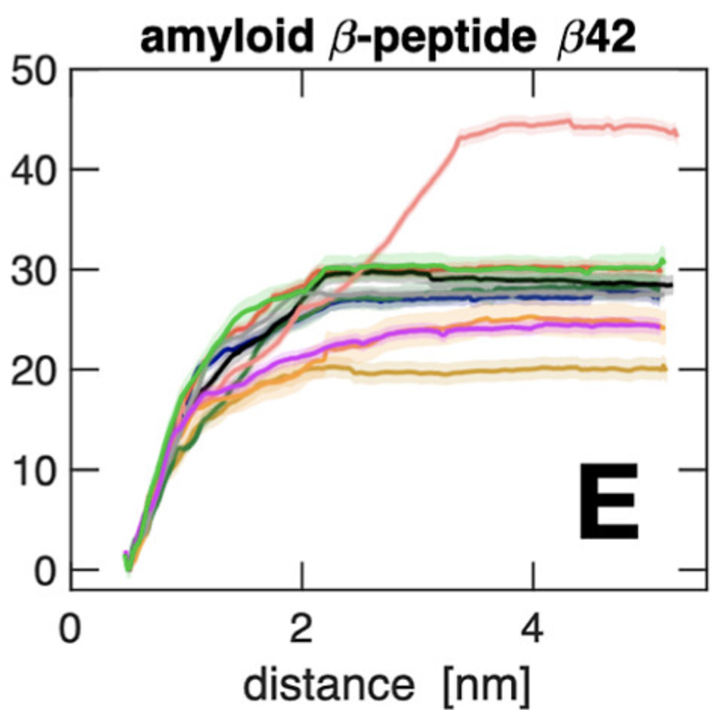


Free energy calculations – Potential of mean Force
Osaka University
Generalize the two-state case to take the free energy along a reaction coordinate $ζ\left(\vec{r}\right)$
Popular choices of $ζ\left(\vec{r}\right)$ in polymer chemistry
Radius of gyration
Solvent accessible surface area
End-to-end distance
Pair-distances between atoms or molecules
Dihedral angles
Secondary structure content
Principal component analysis
Time-lagged independent component analysis
Take the ground state as the most populated stated we obtain:
Aho et al., JCTC, 2024
Notes:
Useful for fast dynamics or need for tricks to speed up the dynamics with the free energy being recoverable afterwards
Examples: Umbrealla sampling, Metadynamics, Wang-Landau, Non-equlibrium pulling.

Slide 24

Free energy calculations – Alchemical transformation
Osaka University
Property of state functions: Path independency
Simulate along an unphysical pathway to obtain free energy between two physical endpoints
Control of interaction strength via new variable $λ$
$\left(λ_{vdw}=0, λ_{ele}=0\right)$ $\left(λ_{vdw}=1, λ_{ele}=0\right)$ $\left(λ_{vdw}=1, λ_{ele}=1\right)$
Hervø-Hansen, Ph.D. Thesis, 2021

Slide 25


Free energy calculations – Alchemical transformation
Osaka University
Thermodynamic integration
Bias from finite number of states, bias from Gaussian quadrature, instability in transformation
Free energy perturbation
Unidirectional transformation, perturbation must be small to obtain reliable results (Important in the upcoming)
Bennett acceptance ratio method
Golden standard, bidirectional, but error can be hard to quantify

Slide 26
Outline
Osaka University
Motivation
Molecular simulations & Free energy calculations
Applications
Controlling protein electrostatics (Protein stability)
Binding and conformational change (Ligand binding)
Co-solvent effects on polymers (Protein solubility)

Slide 27
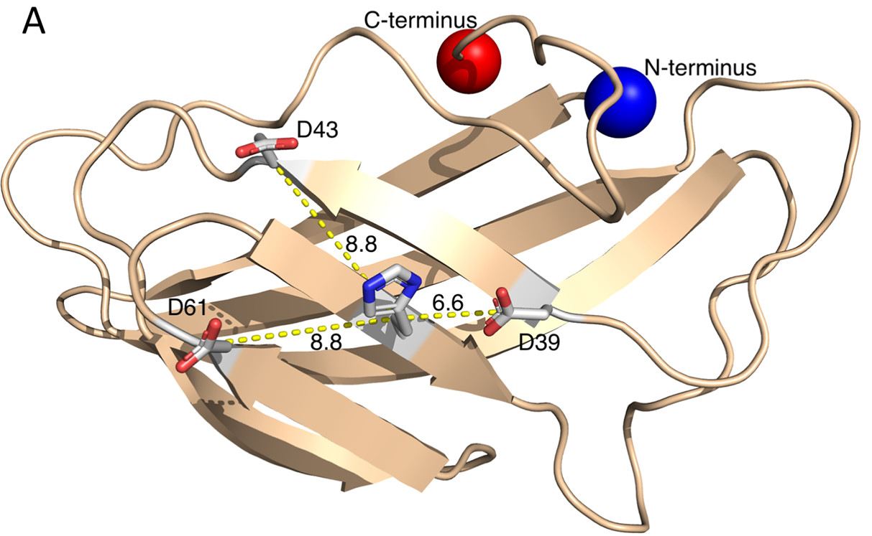
Attempting to control and predict the behavior of protein electrostatics
Osaka University
We constructed a stable chargeless protein and wanted to reintroduce electrostatics
Looking at three different positions of Asp residues surrounding a His residue
How are the protein electrostatics perturbed when we introduce and remove titratable residues in a simple model system?
Hervø-Hansen et al., JACS, 2021

Slide 28
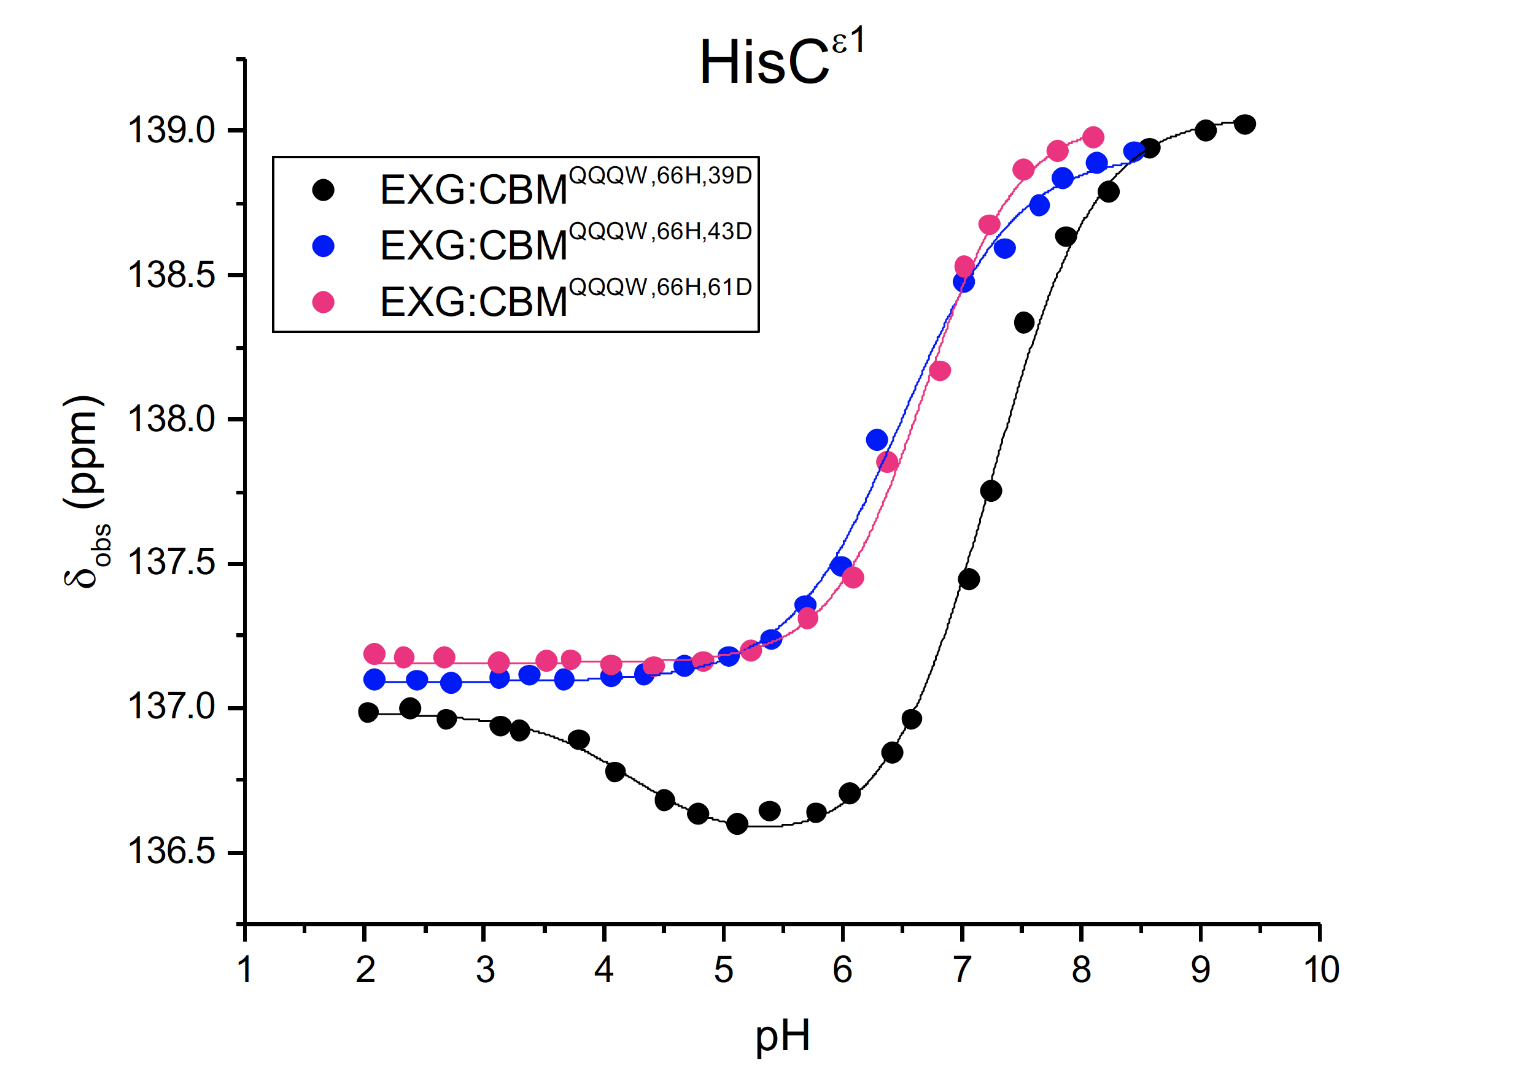
Abnormal NMR titration behavior
Osaka University
Hervø-Hansen et al., JACS, 2021
Notes:
pKa of imidazol: 14.5 (slightly more acidic than alcohols, pKa of ethanol: 16)

Slide 29
pH-Replica Exchange Enhanced Constant pH Molecular Dynamics
Osaka University
Bonds can not be broken due to the description of bonds as harmonic oscillators
Monte Carlo move to change protonation state
Allow simulations to swap pH to gain enhanced sampling between strongly correlated protein configurations and protonation states
Hervø-Hansen et al., JACS, 2021
Notes:
Brute force sampling of discrete protonation states

Slide 30
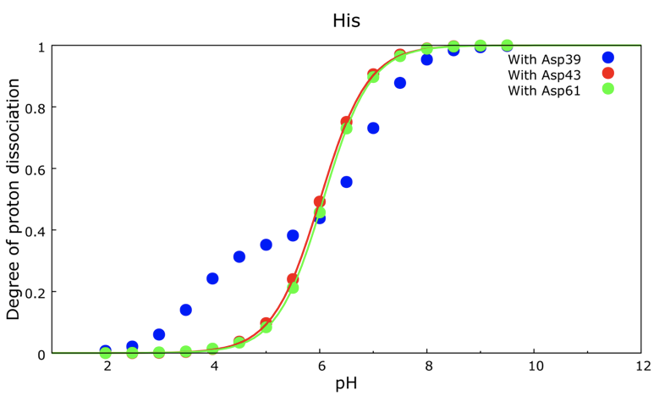
Abnormal NMR titration behavior also observed in simulations
Osaka University
Hervø-Hansen et al., JACS, 2021

Slide 31

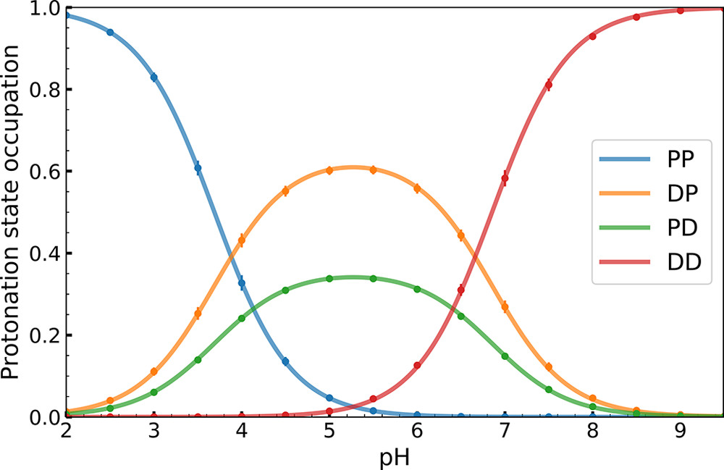
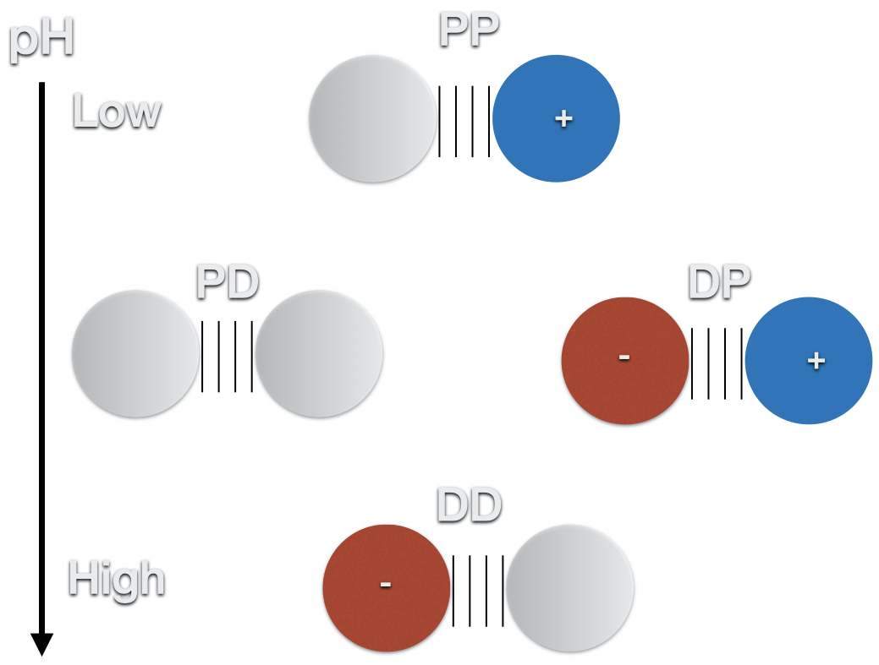
Modeling coupled titratable residues as a diprotic acid
Osaka University
Coupling free energy of 14.6 ± 0.4 kJ/mol
Hervø-Hansen et al., JACS, 2021
Notes:
pKa of imidazol: 14.5 (slightly more acidic than alcohols, ethanol = 16)
Control of salt-bridge vs hydrogen bond

Slide 32
Outline
Osaka University
Motivation
Molecular simulations & Free energy calculations
Applications
Controlling protein electrostatics (Protein stability)
Binding and conformational change (Ligand binding)
Co-solvent effects on polymers (Protein solubility)

Slide 33
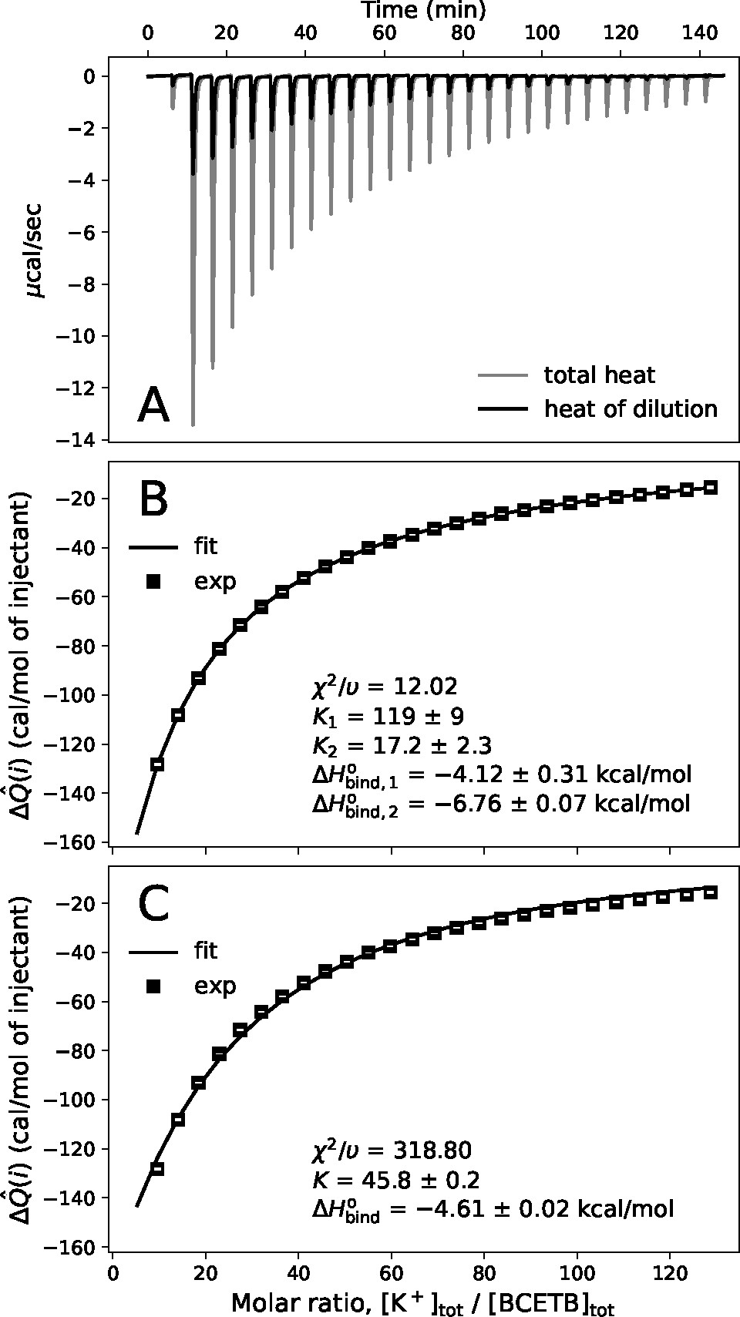
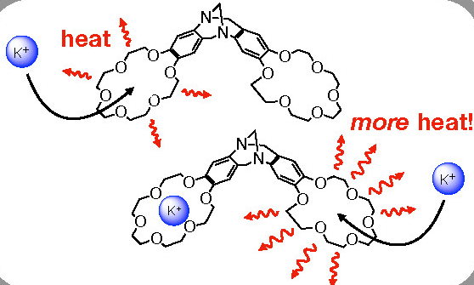

Ion coordination to a Receptor with Two Homotopic Binding Sites
Osaka University
Thermodynamic properties:
$$ΔH_{bind,2}<ΔH_{bind,1}$$
$$ΔG_{bind,2}>ΔG_{bind,1}$$
Aspelin et al., JACS, 2022
Notes:
Binding and conformational change

Slide 34
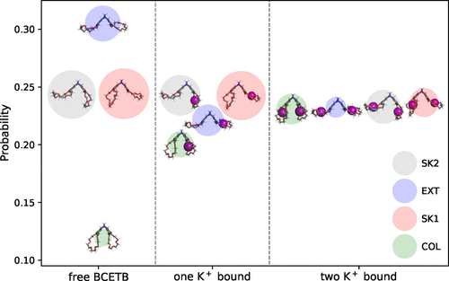
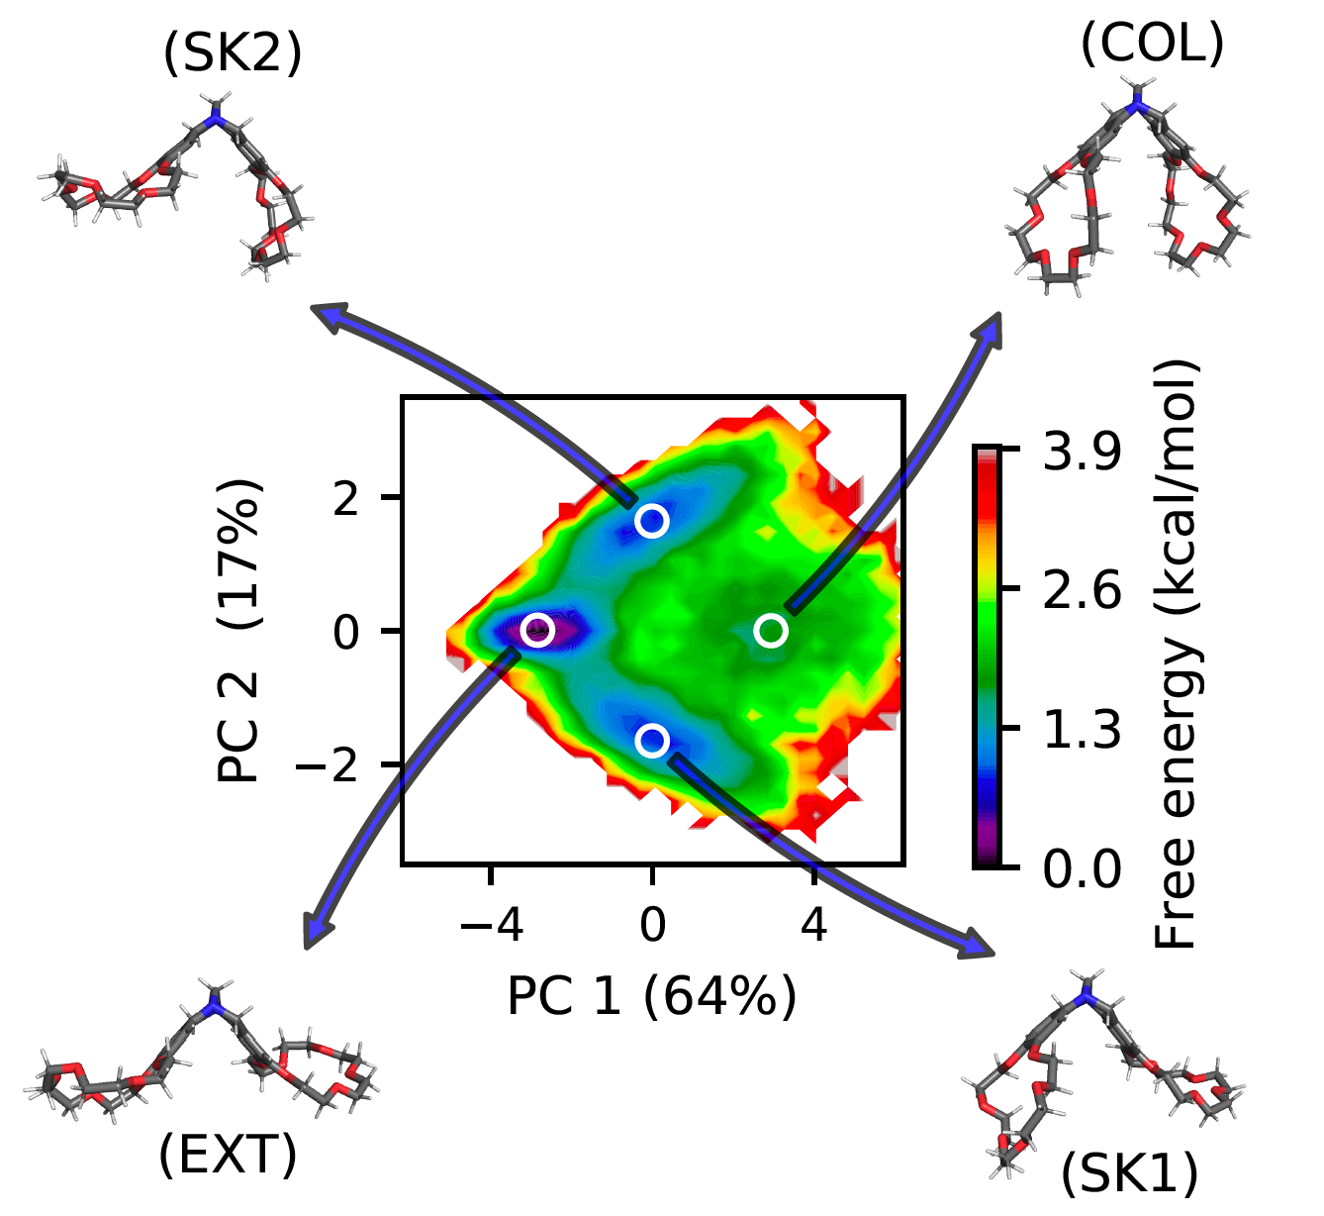
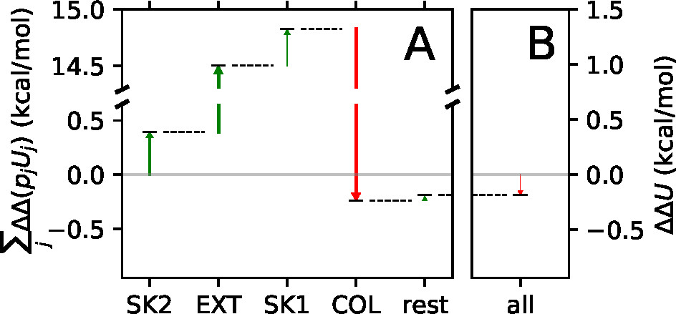
Allosteric effects in small molecule receptors
Osaka University
Aspelin et al., JACS, 2022
Notes:
Binding and conformational change

Slide 35
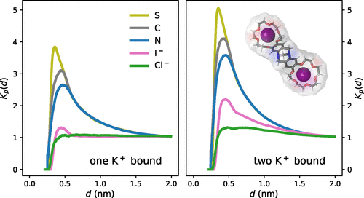

Role of solvent and co-solvent
Osaka University
Coulomb’s Law to describe free energy between charges
$$G_{++}\left(r,T\right)=\frac{e^{2}N_{\text{A}}}{4πϵ_{0}ϵ_{r}\left(T\right)r}$$
$$H_{++}\left(r,T\right)=\frac{∂\left[G_{++}\left(r,T\right)/T\right]}{∂\left(1/T\right)}=G_{++}\left(r,T\right)\left(1+\frac{∂\ln\left[ϵ_{r}\left(T\right)\right]}{∂\ln{T}}\right)$$
Water as a solvent shows very negative temperature response with $\frac{∂\ln\left[ϵ_{r}\left(T\right)\right]}{∂\ln{T}}=−1.37$, yielding
$$H_{++}\left(r,T\right)=−0.37 × G_{++}\left(r,T\right)$$
Aspelin et al., JACS, 2022
Notes:
Continuum model is already capturing some of the physics to get the free energy and enthalpy right.
Van Hoff Relationship to find dH

Slide 36

Role of solvent and co-solvent
Osaka University
Coulomb’s Law to describe free energy between charges
$$G_{++}\left(r,T\right)=\frac{e^{2}N_{\text{A}}}{4πϵ_{0}ϵ_{r}\left(T\right)r}$$
$$H_{++}\left(r,T\right)=\frac{∂\left[G_{++}\left(r,T\right)/T\right]}{∂\left(1/T\right)}=G_{++}\left(r,T\right)\left(1+\frac{∂\ln\left[ϵ_{r}\left(T\right)\right]}{∂\ln{T}}\right)$$
Water as a solvent shows very negative temperature response with $\frac{∂\ln\left[ϵ_{r}\left(T\right)\right]}{∂\ln{T}}=−1.37$, yielding
$$H_{++}\left(r,T\right)=−0.37 × G_{++}\left(r,T\right)$$
Aspelin et al., JACS, 2022
Notes:
Continuum model is already capturing some of the physics to get the free energy and enthalpy right.
Van Hoff Relationship to find dH

Slide 37
Outline
Osaka University
Motivation
Molecular simulations & Free energy calculations
Applications
Controlling protein electrostatics (Protein stability)
Binding and conformational change (Ligand binding)
Co-solvent effects on polymers (Protein solubility)

Slide 38

Protein-Protein and Protein-Excipient Interactions in Formulation
Osaka University
Construction of comprehensive protein library
Study of many proteins to investigate the importance of various properties
Interactions with co-solvents and self-association
Computational delivery mainly focused on protein characterization
Structure – Thermodynamics relationship?
Notes:
Parameters obtained from analysis such as normal mode analysis or fast computation methods.

Slide 39
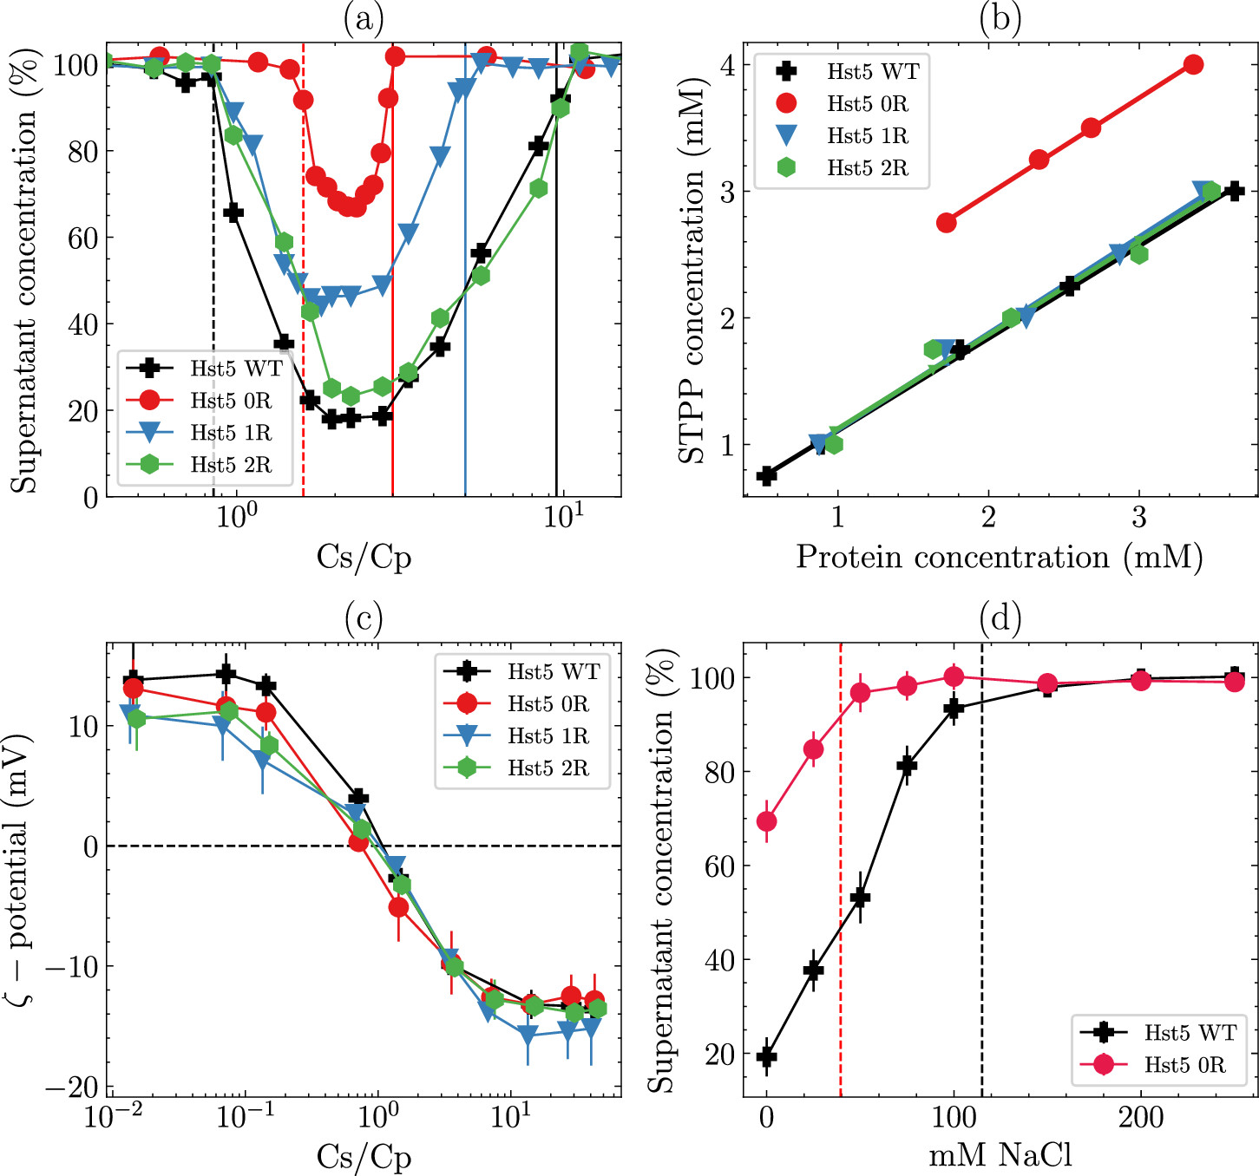
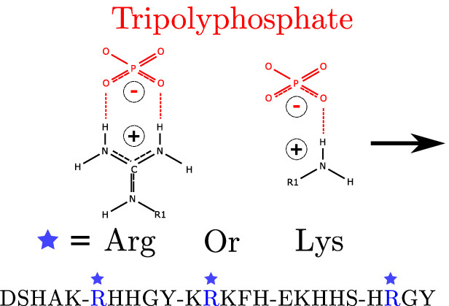
Example: Histatin-5’s reentrant condensation modulation by cosolvent and mutagenesis
Osaka University
Reentrant condensation of histatin-5 controlled by:
Arginine-to-lysine substitutions
Electrostatic interactions
Lenton et al., Biomacromolecules, 2021
Notes:
Conserved mutations yielded highly different results.

Slide 40
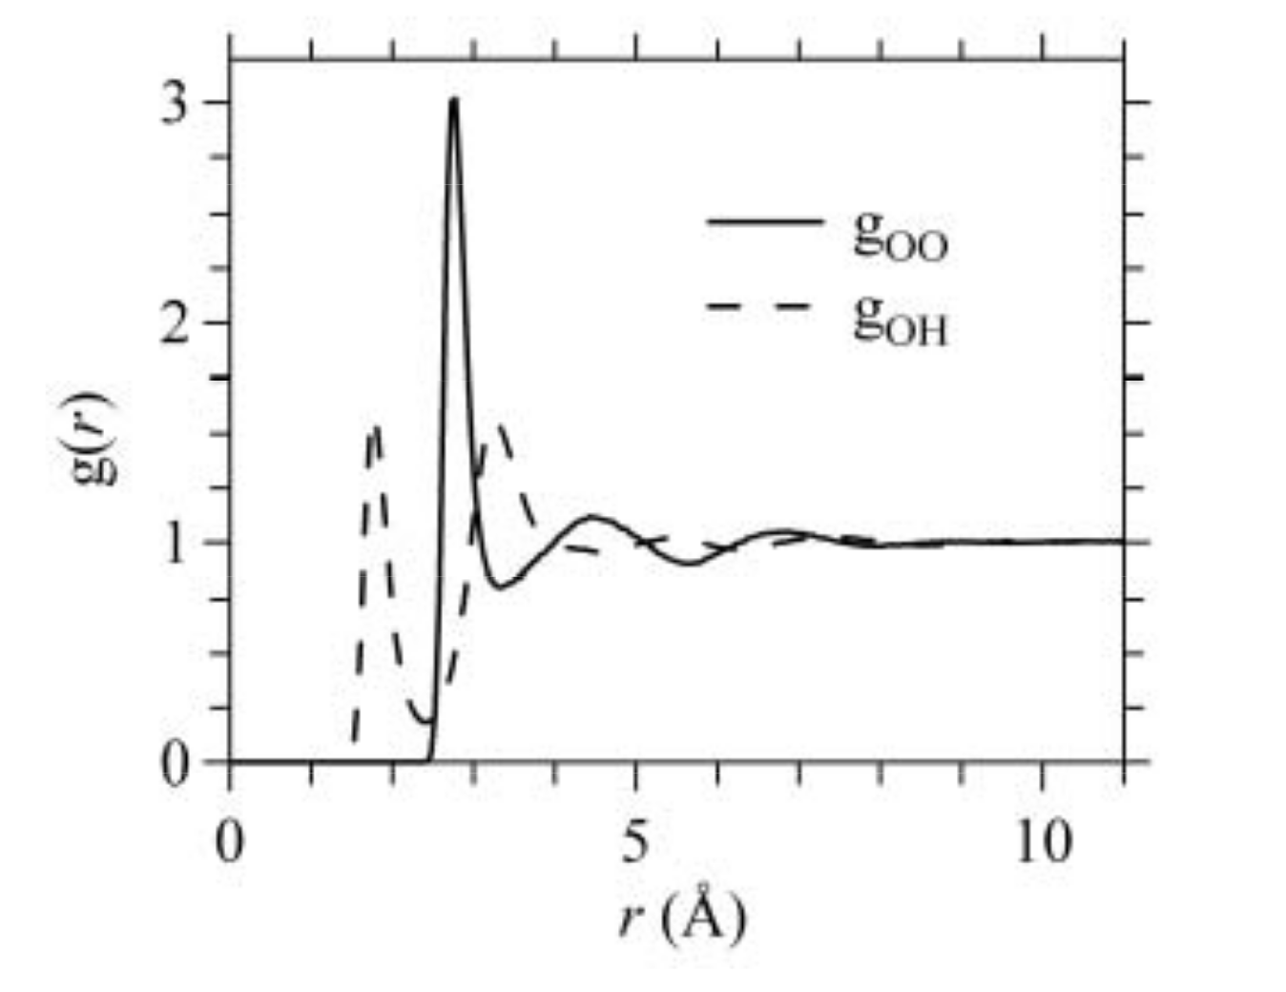
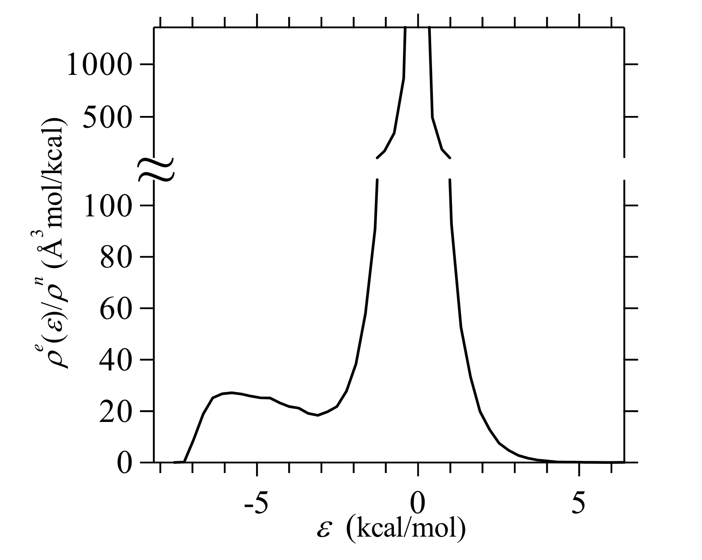

Energy-Representation Theory of Solvation
Osaka University
Kirkwood Charging Formula
$$ΔG=\int_{0}^{1}{dλ\int_{−∞}^{+∞}{dx_{s}^{′}}}dx_{w}^{′}\frac{∂u_{sw,λ}\left(x_{s}^{′},x_{w}^{′}\right)}{∂λ}ρ_{sw,λ}\left(x_{s}^{′},x_{w}^{′}\right)$$
Use pair-energy distribution at $λ=1$ to obtain an expression for the chemical potential on the following form:
$$ΔG=\sum_{\text{species},i}{ΔG_{\text{sol},i}}$$
$$ΔG_{i}=\int{ρ_{i}\left(ϵ\right)ϵ} \text{d}ϵ−\int{ℱ_{i}\left(ε\right) \text{d}ε}$$
Notes:
RISM (reference interaction site model): Distances between chemical species
Energy-representation: Pair-energy between chemical species
A lot of the same information is contained in the two representations
Plots: liquid water.

Slide 41
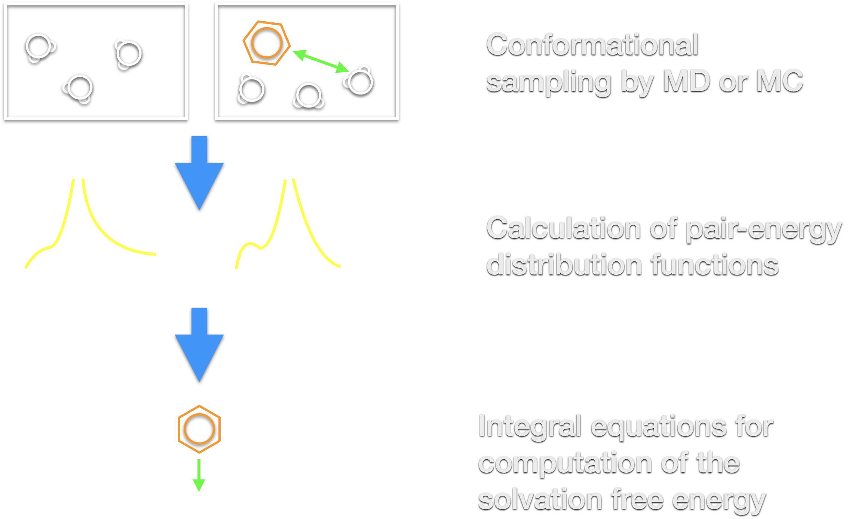
Energy-Representation Theory of Solvation: The Practical Details
Osaka University

Slide 42
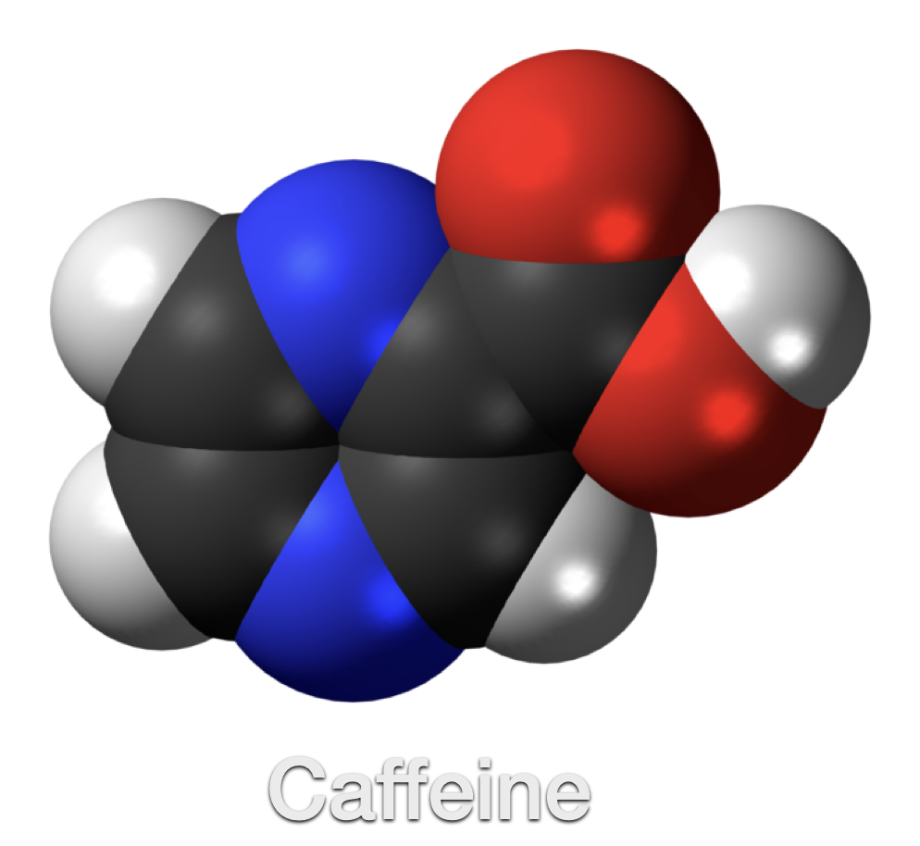
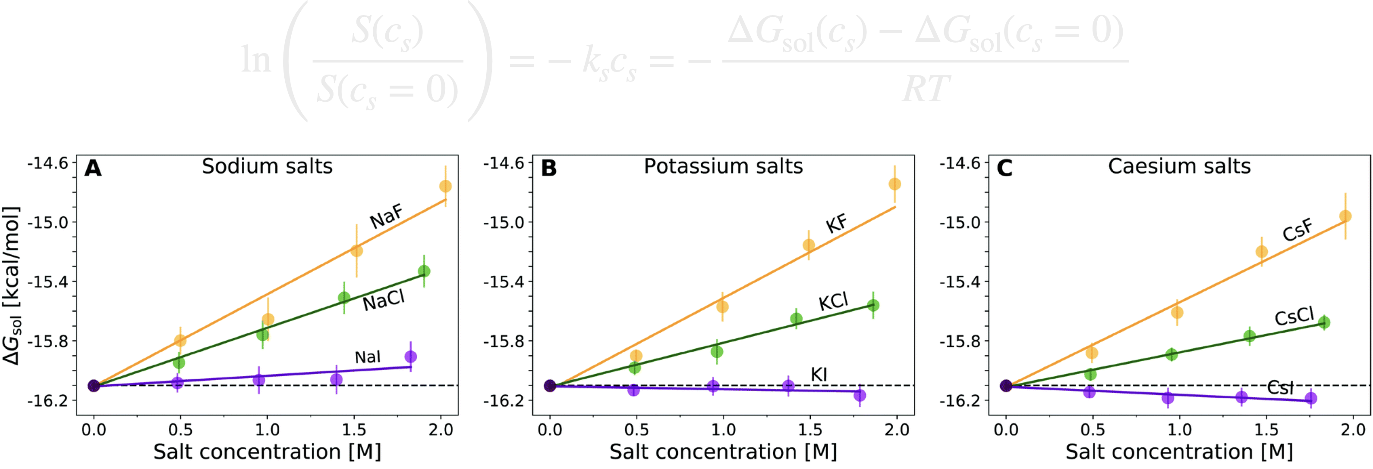
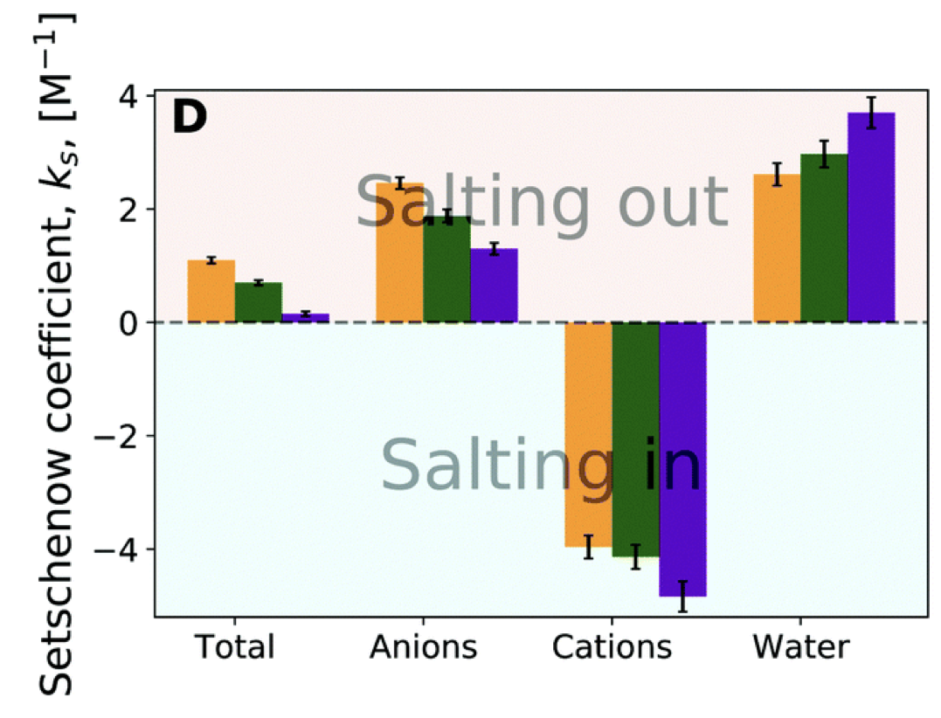
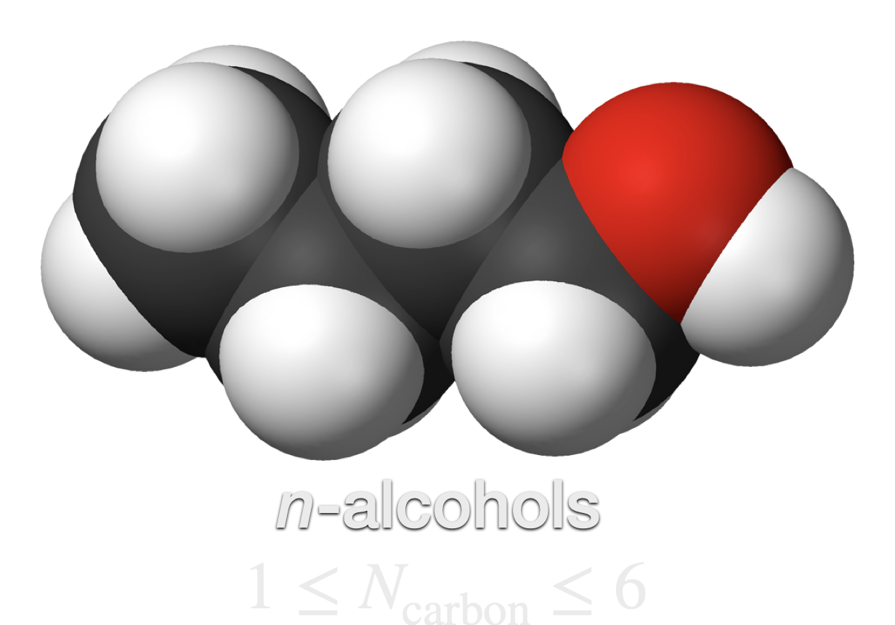
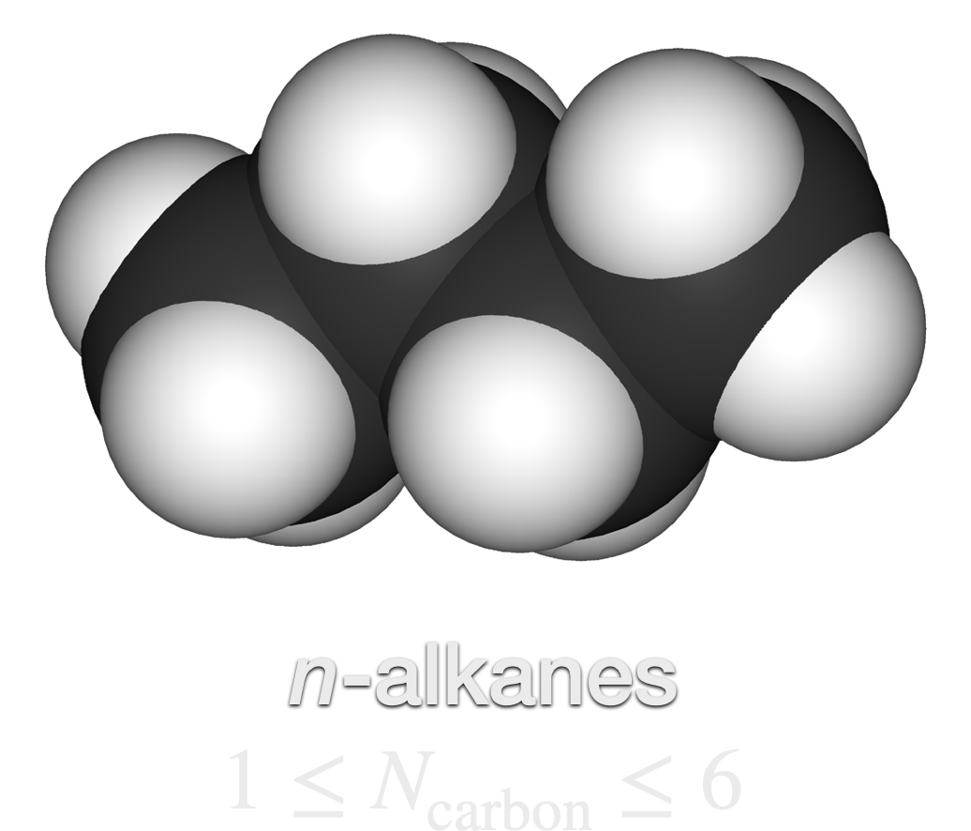
Intermezzo: Small molecule solvation determined by energy-representation theory of solvation
Osaka University
Hervø-Hansen et al., PCCP, 2022
Hervø-Hansen et al., Chem. Sci., 2024
Notes:
The interaction component: Favorable interactions between co-solvent and solute may not necessarily positively correlate with increased solubility.
The excluded volume component: Depends on the solute size and how a co-solvent alters the probability of instantaneous cavity formation.
This is related to the concepts of kosmotropy and chaotropy, which are mainly determined from solvent-cosolvent interactions.

Slide 43
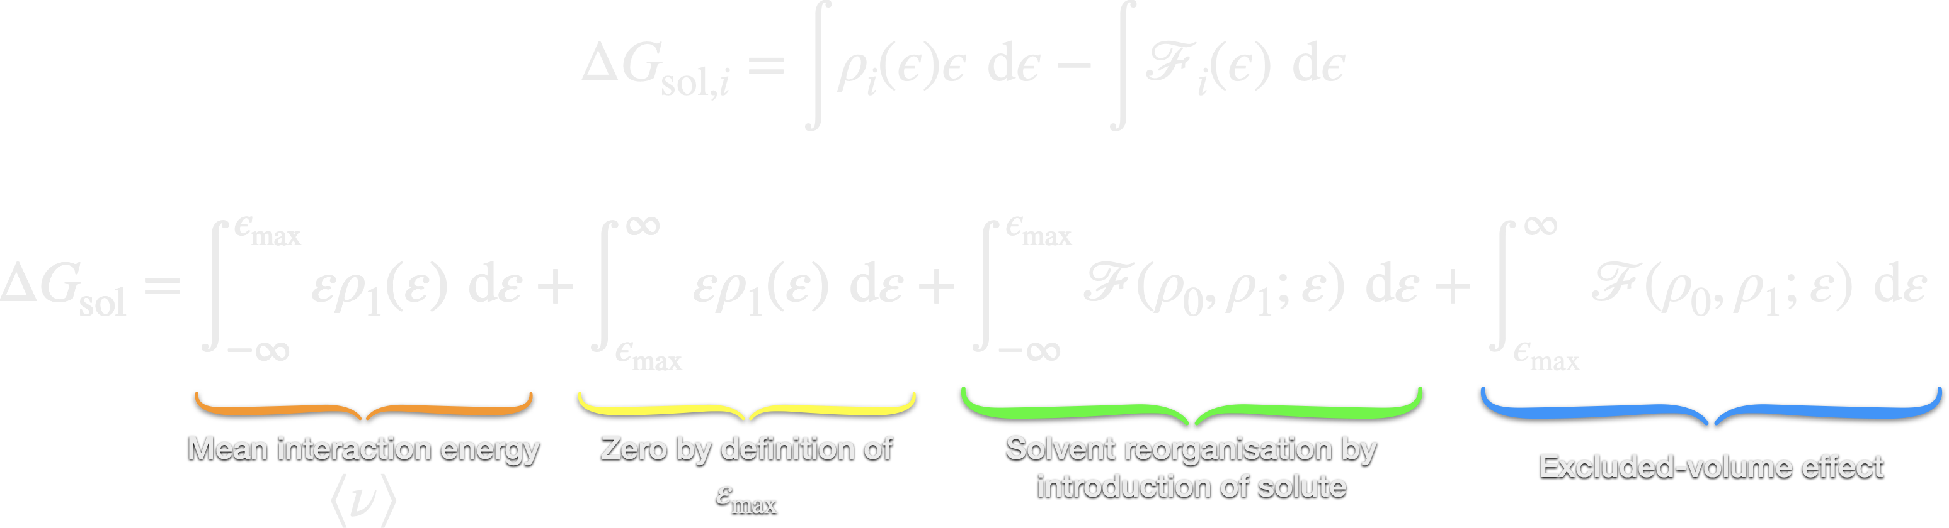
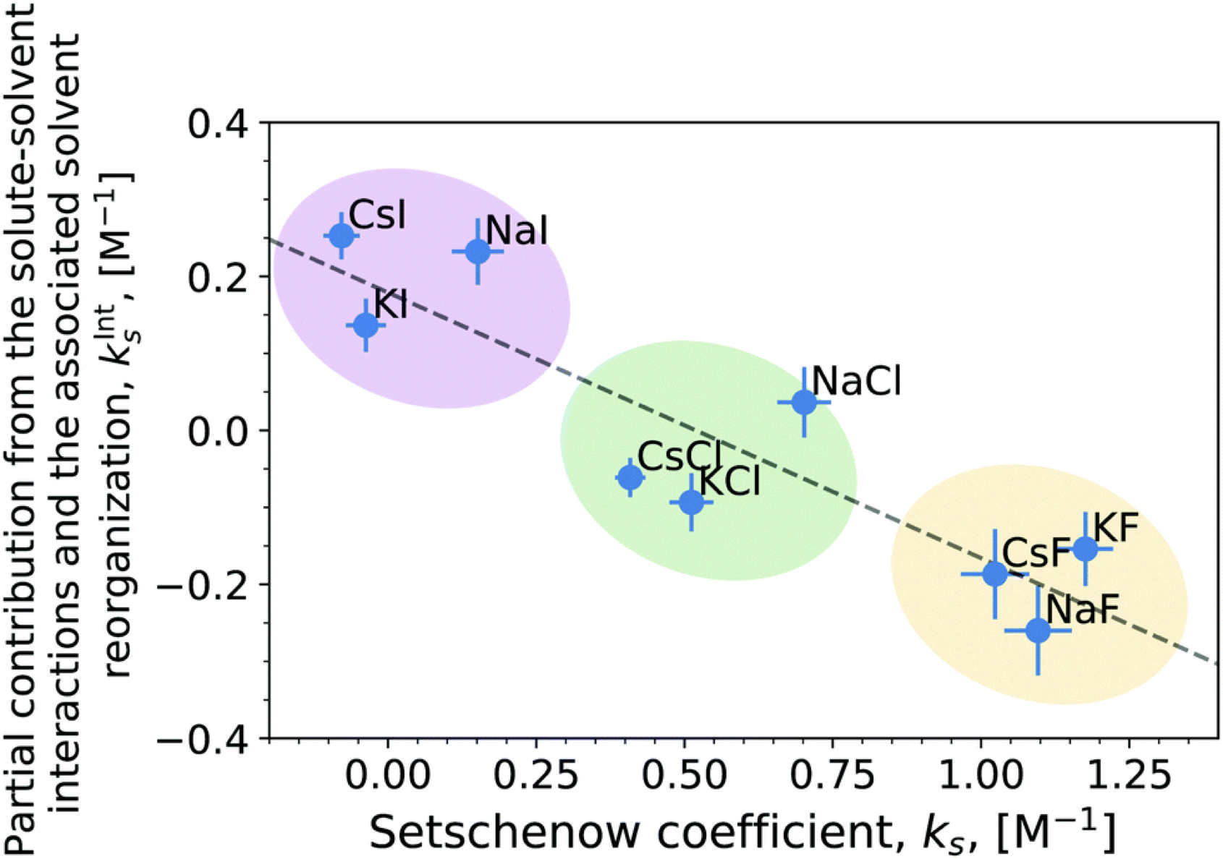
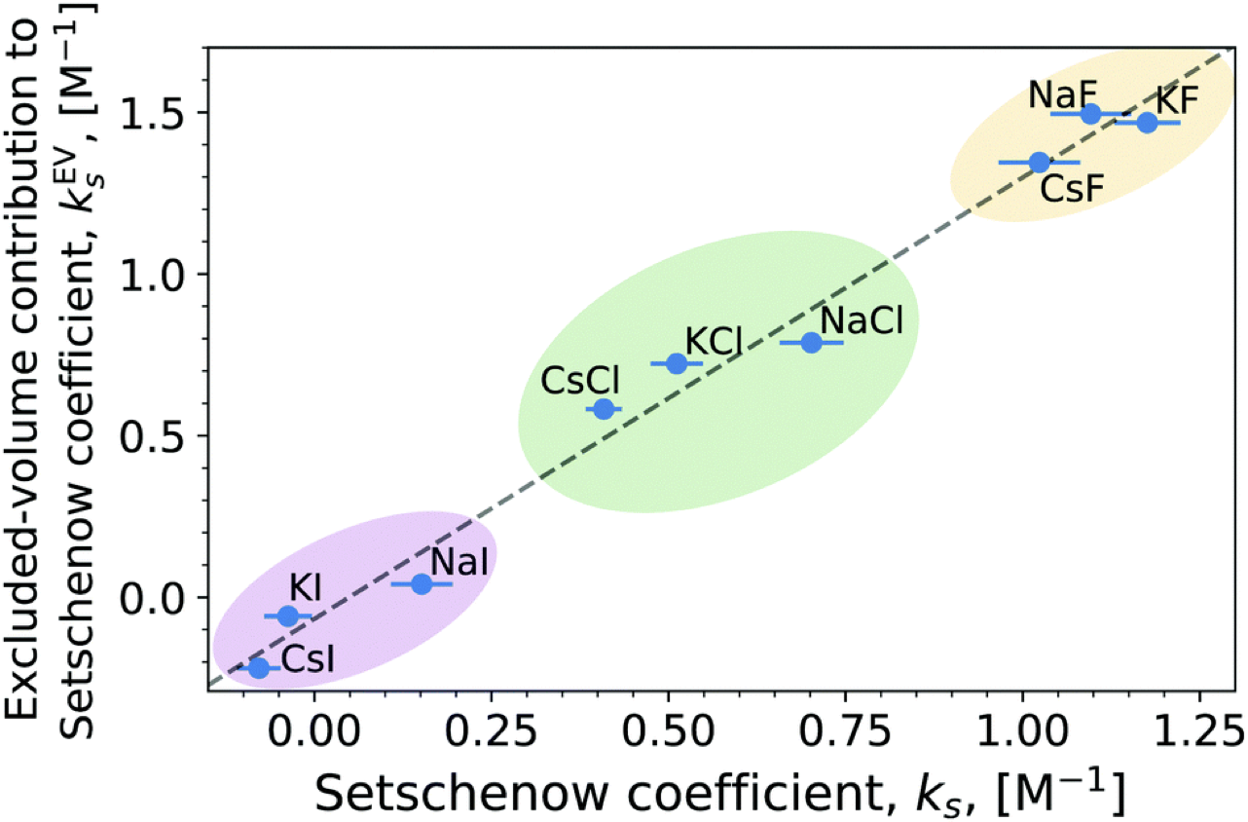
Intermezzo: Small molecule solvation determined by energy-representation theory of solvation
Osaka University

Slide 44
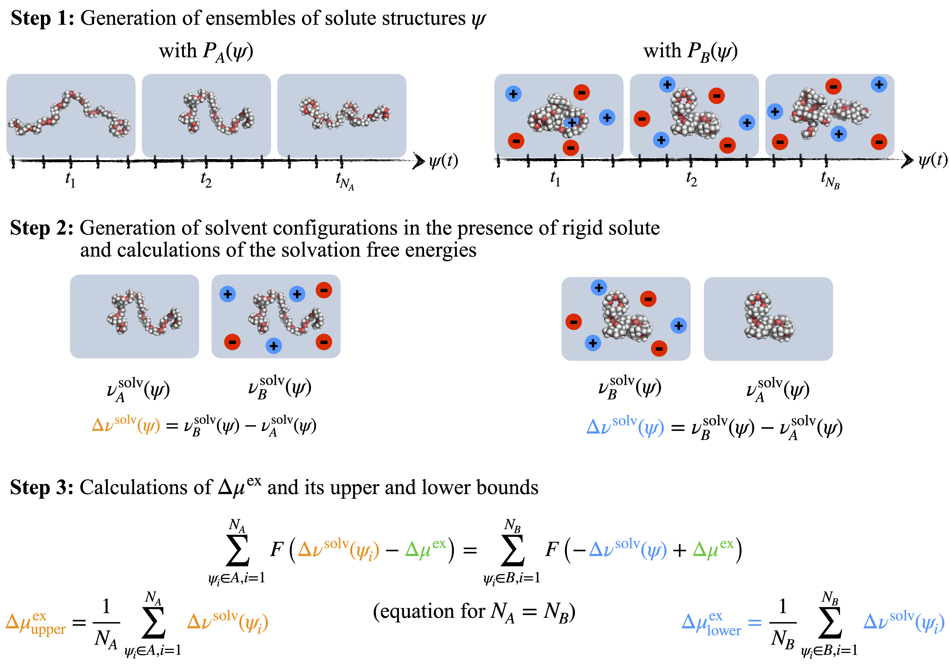

Polymer solvation determined by energy-representation theory of solvation
Osaka University
Vacuum-to-solvent route is too expensive
$$P_{B}\left(ψ\right)=P_{A}\left(ψ\right)e^{β\left(ΔG−Δν^{\text{solv}}\left(ψ\right)\right)}$$
$ψ$: solute configuration
$ν_{A}^{\text{solv}}\left(ψ\right),ν_{B}^{\text{solv}}\left(ψ\right)$: solvation free energies in solvent conditions $A,B$
$$ΔG=\int{P_{A}\left(ψ\right)Δν^{\text{solv}}\left(ψ\right)\text{d}ψ}$$

Slide 45
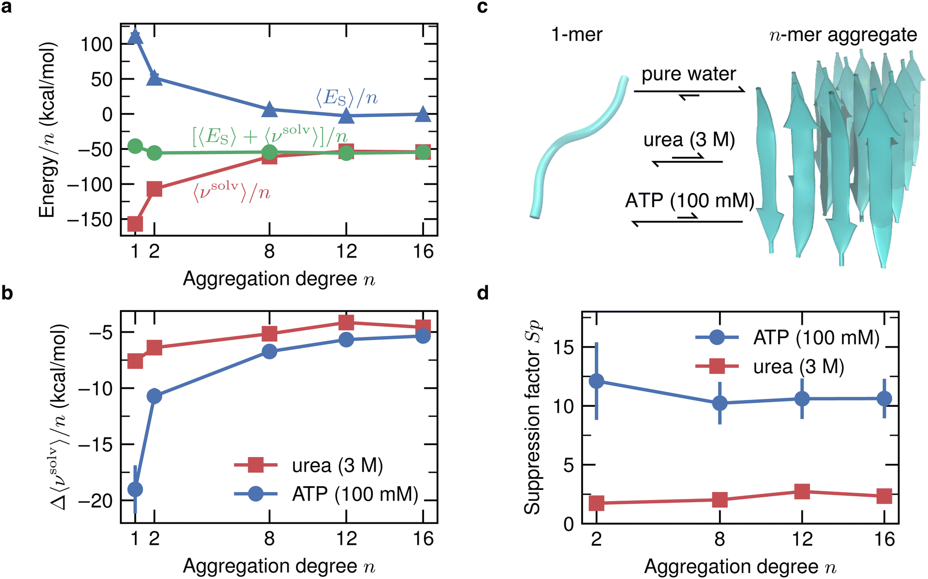
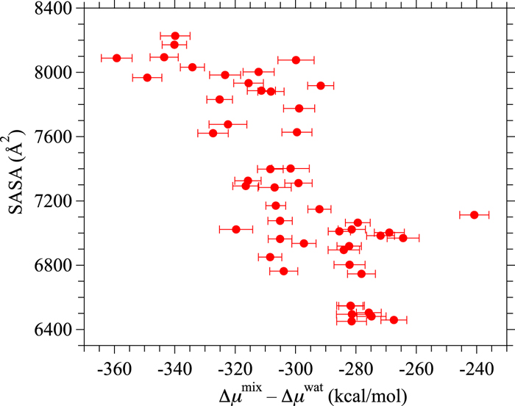
Polymer solvation determined by energy-representation theory of solvation
Osaka University
Free energy analysis of the fibrillation of Aβ₁₆₋₂₂ in the presence of urea and ATP
Free energy analysis of cytochrome c in water and 8 M urea
Yamamori et al., J. Chem. Phys, 2016
Minh Do et al., PCCP, 2024

Slide 46

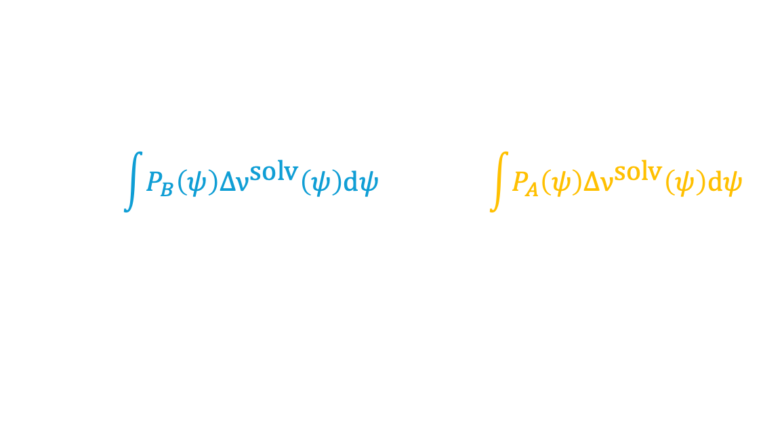
Polymer solvation determined by energy-representation theory of solvation
Osaka University
Their approach assumed that the structural ensemble is invariant with the co-solvent concentration
$$P_{B}\left(ψ\right)=P_{A}\left(ψ\right)e^{β\left(ΔG−Δν^{\text{solv}}\left(ψ\right)\right)}$$
Solve the same equation using the higher order terms
$$\int{P_{B}\left(ψ\right)Δν^{\text{solv}}\left(ψ\right)\text{d}ψ}≤ΔG≤\int{P_{A}\left(ψ\right)Δν^{\text{solv}}\left(ψ\right)\text{d}ψ}$$
Hervø-Hansen et al., JCTC, Submitted (2024)

Slide 47
Polymer solvation determined by energy-representation theory of solvation
Osaka University
Like with free energy perturbation we have two unidirectional estimators.
Develop a new bidirectional estimator akin to a coarse-grained Bennett Acceptance Ratio (BAR) method.
Difference between original BAR and “new BAR” is the solute is decoupled from the solvent.
Hervø-Hansen et al., JCTC, Submitted (2024)

Slide 48
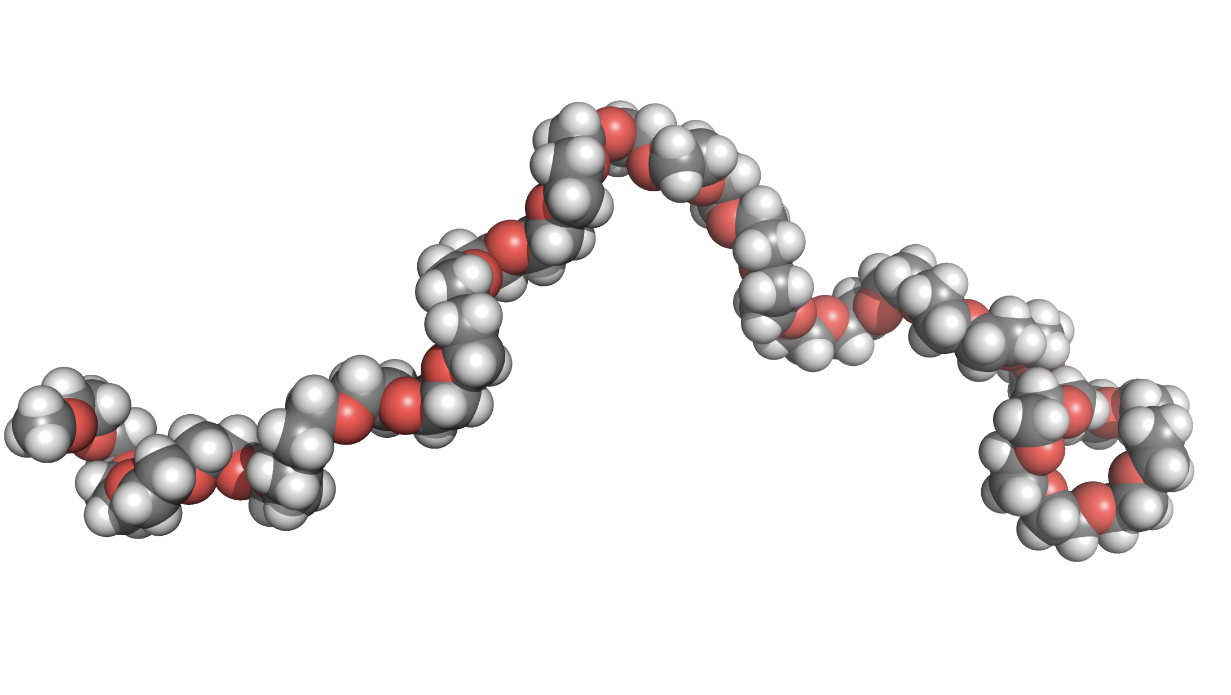
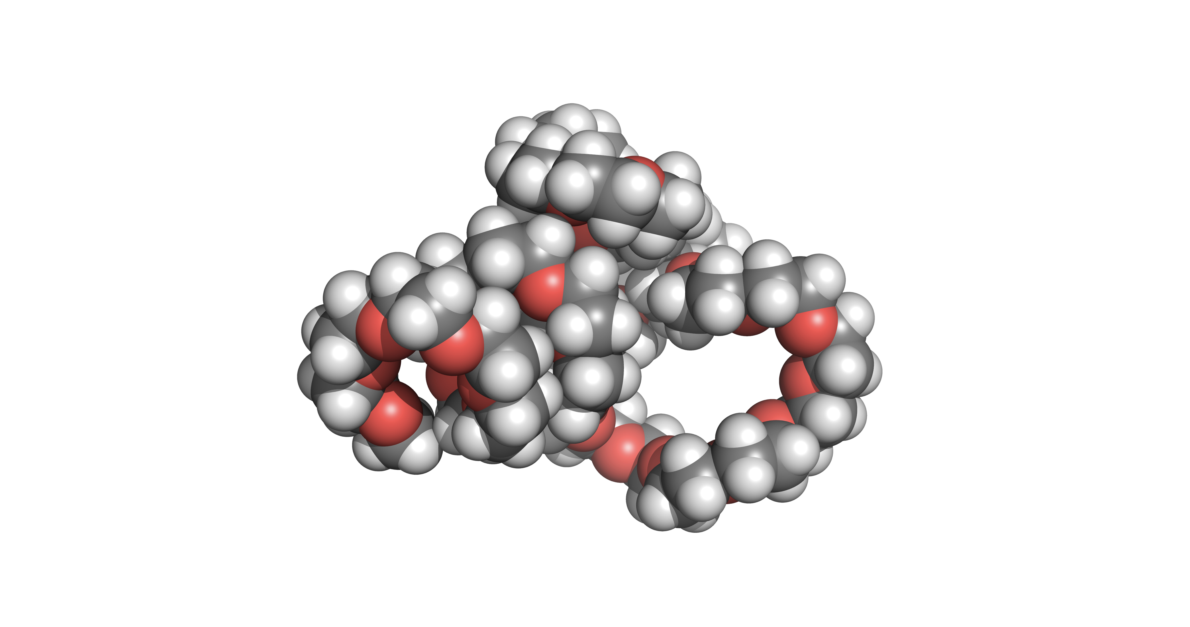

Polymer solvation determined by energy-representation theory of solvation
Osaka University
Configuration in water
$$P_{\text{water}}\left(ψ\right)≈P_{\text{urea}}\left(ψ\right)$$
$$P_{\text{water}}\left(ψ\right)≠P_{\text{NaCl}}\left(ψ\right)$$
Configuration in NaCl
Hervø-Hansen et al., JCTC, Submitted (2024)
Hervø-Hansen et al., In preparation

Slide 49
Polymer solvation determined by energy-representation theory of solvation
Osaka University
$$P_{\text{water}}\left(ψ\right)≈P_{\text{urea}}\left(ψ\right)$$
$$P_{\text{water}}\left(ψ\right)≠P_{\text{NaCl}}\left(ψ\right)$$
Hervø-Hansen et al., JCTC, Submitted (2024)
Hervø-Hansen et al., In preparation

Slide 50
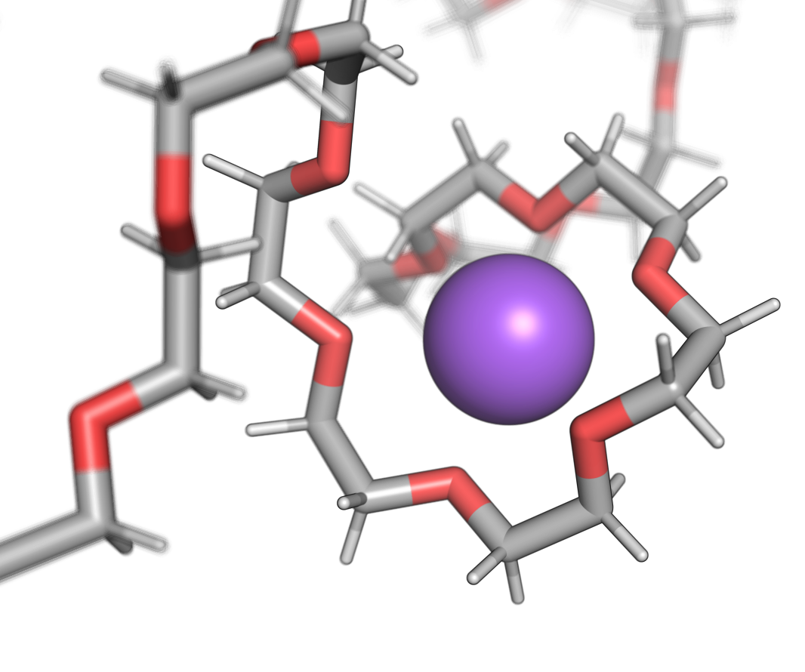
Polymer solvation determined by energy-representation theory of solvation
Osaka University
Hervø-Hansen et al., JCTC, Submitted (2024)
Hervø-Hansen et al., In preparation

Slide 51
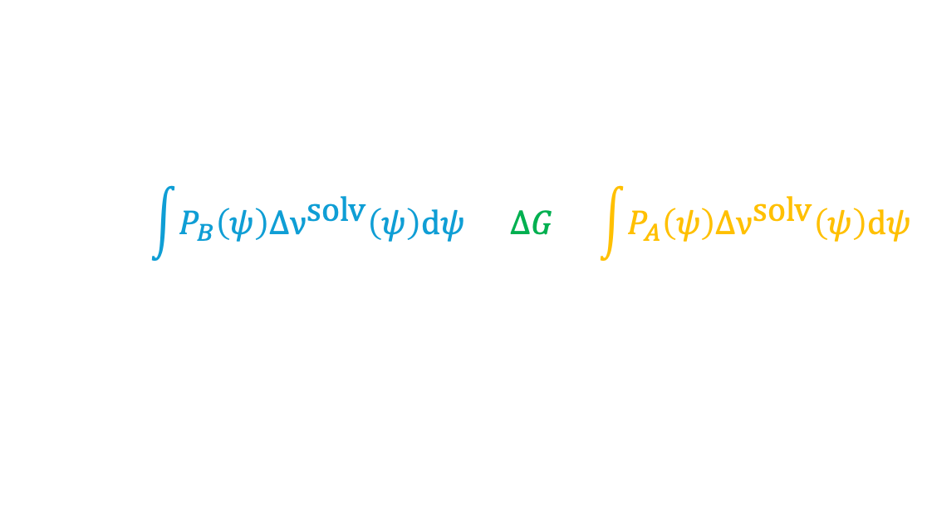
Polymer solvation determined by energy-representation theory of solvation
Osaka University
$$\int{P_{B}\left(ψ\right)Δν^{\text{solv}}\left(ψ\right)\text{d}ψ}≤ΔG≤\int{P_{A}\left(ψ\right)Δν^{\text{solv}}\left(ψ\right)\text{d}ψ}$$
Hervø-Hansen et al., In preparation

Slide 52
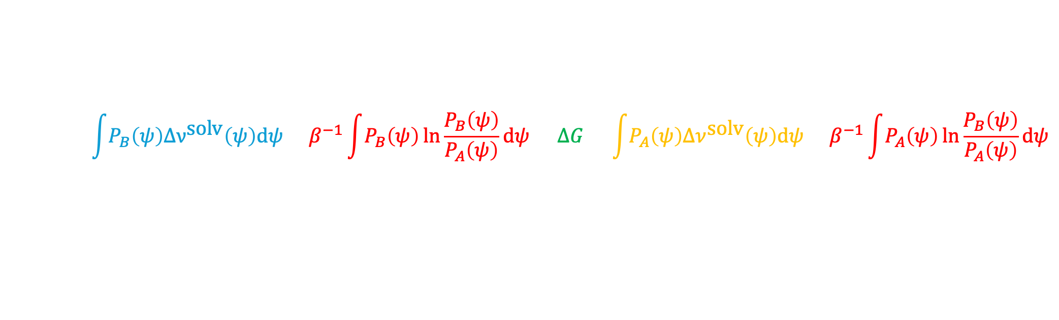
Polymer solvation determined by energy-representation theory of solvation
Osaka University
$$\int{P_{B}\left(ψ\right)Δν^{\text{solv}}\left(ψ\right)\text{d}ψ}+β^{−1}\int{P_{B}\left(ψ\right)}\ln{\frac{P_{B}\left(ψ\right)}{P_{A}\left(ψ\right)}}\text{d}ψ=ΔG=\int{P_{A}\left(ψ\right)Δν^{\text{solv}}\left(ψ\right)\text{d}ψ}+β^{−1}\int{P_{A}\left(ψ\right)}\ln{\frac{P_{B}\left(ψ\right)}{P_{A}\left(ψ\right)}}\text{d}ψ$$
Hervø-Hansen et al., In preparation

Slide 53

Polymer solvation determined by energy-representation theory of solvation
Osaka University
$$ΔG_{lower}+K_{B}TD_{KL}\left[\left.P_{A}(ψ\right)||\left.P_{B}(ψ\right)\right]=ΔG=ΔG_{upper}−K_{B}TD_{KL}\left[\left.P_{B}(ψ\right)||\left.P_{A}(ψ\right)\right]$$
Kullback-Leibler divergence (relative entropy):
Reversible work in transforming the polymer structure into its relaxed conformational ensemble.
Hervø-Hansen et al., In preparation

Slide 54
Where do we continue from here?
Osaka University
We have developed:
An working method for larger molecules.
Free energy – polymer structure correlation analysis.
Arbitrary free energy decomposition to gain mechanistic insight.
A solvent decomposition methodology.
Decoupling scheme of conformational free energy and perturbation due to mutation and/or solvent.
Analyze fascinating protein properties to establish principles to acquire or enhance said properties.

Slide 55
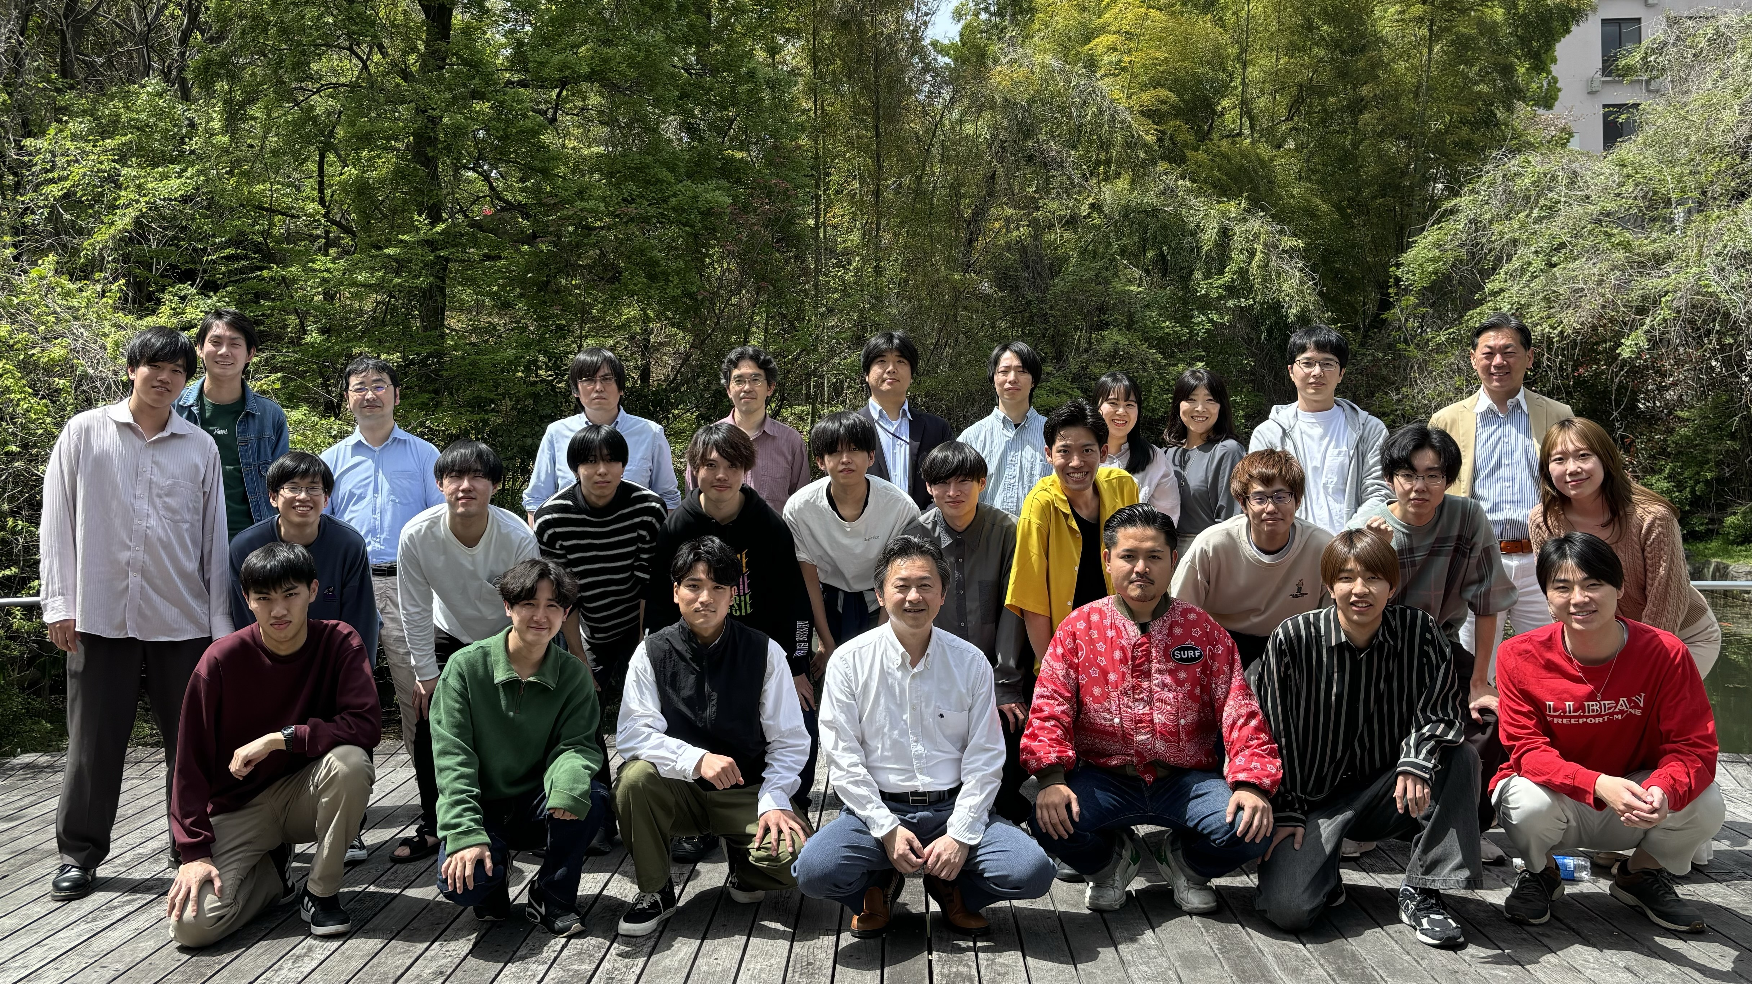


Thank you for listening
Osaka University
contact
and slides

